Slide 1
VHIMS Central Solution
Consumer Experience Outcomes and Safety | December 2024
Victorian Health Incident Management System
End User Training - Feedback

Slide 2
Table of contents
Select any section to go directly to that page.
1. System access | 3
1.1 Registration | 4
1.2 Logging in | 5
4. Recording feedback | 18
4.1 What | 21
4.2 When & where | 22
4.3 Who | 23
7. Resolution | 33
8. Sign-off | 35
2. System roles and permissions | 6
9. Documents | 38
5. Classification | 24
5.1 Complaint classification | 26
5.2 Complaint severity rating | 27
3. Feedback dashboard | 9
3.1 Defaults | 11
3.2 Applying a filter | 12
3.3 Searching for feedback | 13
3.5 Edit existing feedback | 14
3.6 Export to PDF | 15
3.7 Read/unread records | 16
3.8 Feedback data export | 17
10. History | 40
11. Logging off | 42
6. Actions | 28
6.1 Definitions | 29
6.2 Adding an action | 30
6.3 Investigations | 31
6.4 Recording your own actions | 32
12. For further information | 44

Slide 3
System access
System access

Slide 4
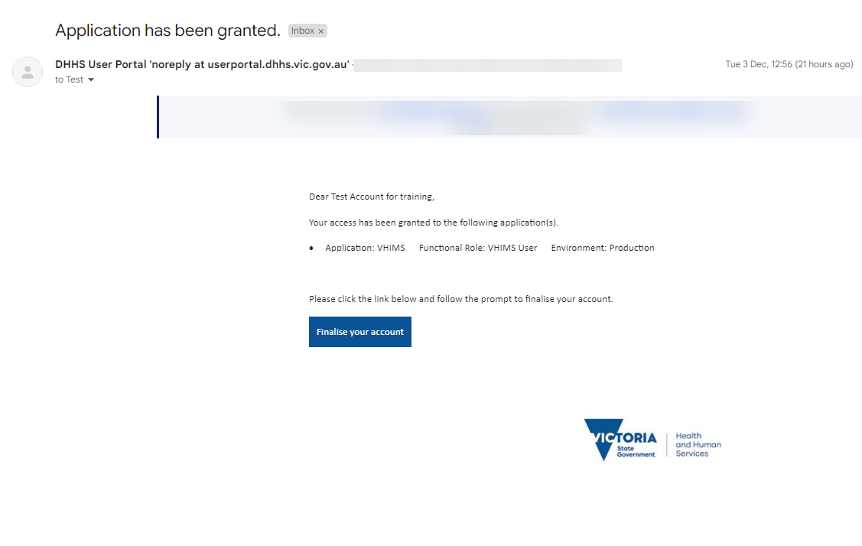
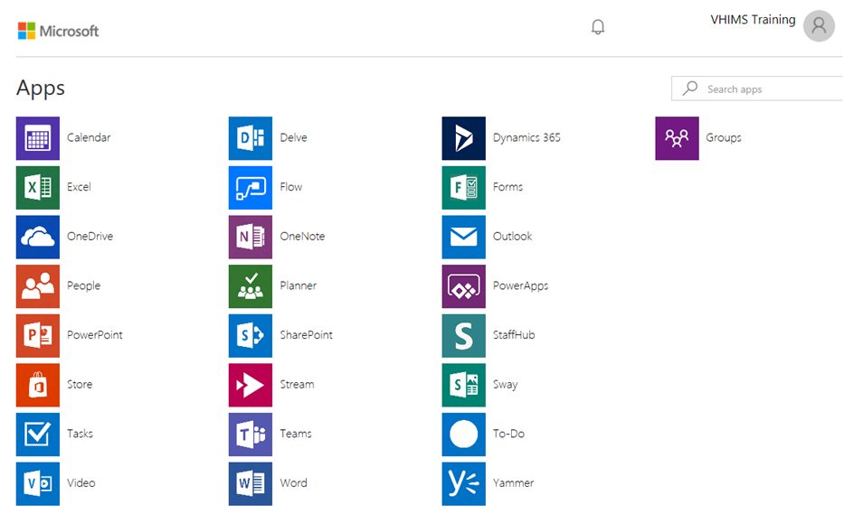
System access - registration
VHIMS CS is hosted in a cloud-based environment called Microsoft Azure.
Once VHIMS Support have added a new user to the system, the staff member will receive an individual once-off email (example below) to complete their account set up.
A dashboard with applications may appear (example below).
Close this page when you land on the dashboard.
Proceed to your VHIMS CS site and login to access the system.
New staff will need to click ‘Finalise your account’ to activate their Azure account.
Follow the instructions (if provided).

Slide 5
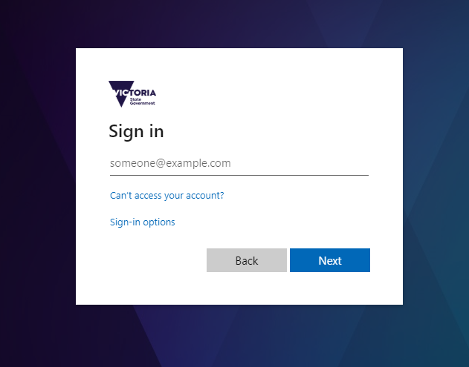
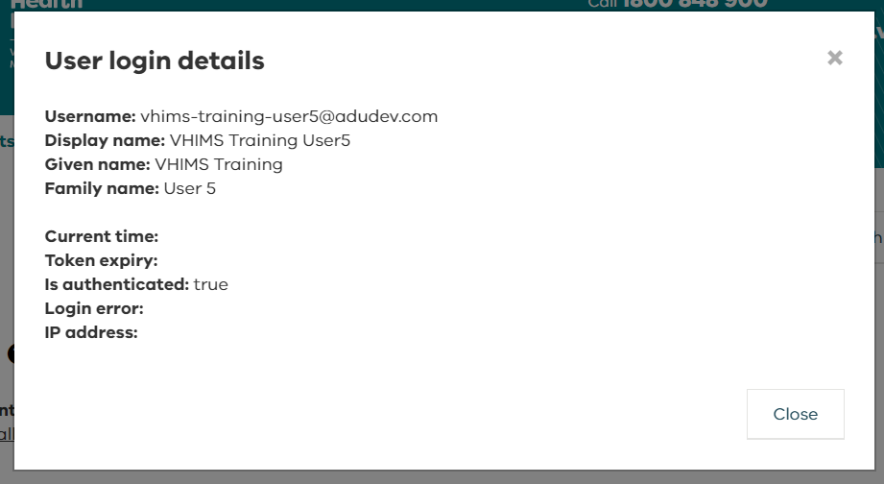
System access – logging in
The link to your live VHIMS CS system will be available through your organisation.
Your login information for the live VHIMS CS system will be:
Username: your work email
Password*: your Microsoft Azure password (usually the same as your work email password)
*Depending on how your organisation is set up, you may also be prompted to change or create a password when you log in.
If you get an error when attempting to log in, it may be because you are using a shared computer and another user has not logged off.
To see who is logged in, click the round button in the top right corner:

Slide 6
Roles and permissions
VHIMS CS system roles and permissions

Slide 7
VHIMS CS system roles and permissions
A user can only be assigned one VHIMS CS system role.
The system role that is assigned to a user will determine what incidents they can see via their dashboards, and what sections of the VHIMS CS system they have permission to access.
All system roles (with the exception of the Organisation Admin role) have access to the Incidents tab and the Actions tab.
Most users are assigned the role of Reporter, Staff or Manager.
Speak to your local VHIMS CS administrator if you think you need a different system role.
You can find more information in the Roles and Permissions resource.

Slide 8
Overview of VHIMS CS system roles and permissions
 | Permissions | Reporter | Staff | Manager | OHS Manager | CLO | Risk Manager | Executive | Helpdesk | Organisation Admin
INCIDENTS | Create Incidents |  |  |  |  |  |  |  |  | 
 | View/edit OHS incidents created by another user on my behalf |  |  |  |  |  |  |  |  | 
 | View/edit incidents containing actions that are assigned to me |  |  |  |  |  |  |  |  | 
 | View/edit all incidents as routed by notification rules |  |  |  |  |  |  |  |  | 
 | View all ‘clinical’ incidents within my organisation on my incident dashboard |  |  |  |  |  |  |  |  | 
 | View all ‘OHS’ incidents and ‘Hazards’ within my organisation on my incident dashboard |  |  |  |  |  |  |  |  | 
 | View ALL incidents within my organisation on my incident dashboard |  |  |  |  |  |  |  |  | 
 | Be a line manager |  |  |  |  |  |  |  |  | 
 | Manage incidents (edit Why & How, close / re-open incidents) |  |  |  |  |  |  |  |  | 
FEEDBACK | Create Feedback |  |  |  |  |  |  |  |  | 
 | Manage feedback (close / re-open feedback) |  |  |  |  |  |  |  |  | 
 | Remove/ Restore incident and feedback records |  |  |  |  |  |  |  |  | 
 | View ALL feedback records within my organisation on my feedback dashboard |  |  |  |  |  |  |  |  | 
REPORTS | View Reports |  |  |  |  |  |  |  |  | 
 | Access Incident extract (full data extract for Incidents) |  |  |  |  |  |  |  |  | 
 | Access Feedback extract (full data extract for feedback) |  |  |  |  |  |  |  |  | 
OTHER | Access Actions |  |  |  |  |  |  |  |  | 
 | View incidents as Read/Unread on Incident, Feedback, and Actions dashboards |  |  |  |  |  |  |  |  | 
 | Access My Profile to delegate my permissions |  |  |  |  |  |  |  |  | 
 | View/edit all incidents that another user has access to, if they have delegated to me |  |  |  |  |  |  |  |  | 
 | Access the Administration module (Users, Teams, Notifications, and Organisation) |  |  |  |  |  |  |  |  | 

Slide 9
Feedback dashboard
Feedback dashboard

Slide 10
Feedback dashboard
The feedback module is only available for certain system profiles (refer to roles and permissions).
When you log in to VHIMS CS, the system will land on the Incidents dashboard.
Select Feedback from the tabs at the top to navigate to the Feedback dashboard.
The feedback dashboard will display all feedback across the organisation.

Slide 11
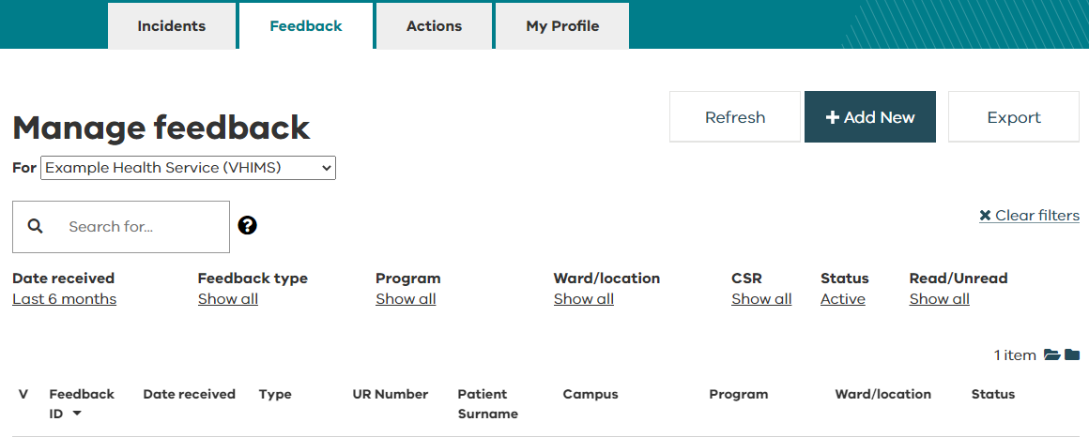
Feedback dashboard – defaults
The dashboard will default to display only ‘Active’ feedback received in the last six months.
‘Active’ feedback have a status of open or outstanding actions.
Incident status | Definition
Open | Feedback has been recorded.
Outstanding actions | One or more actions are open.
Closed | The feedback has been signed off. Feedback that have been signed off even if there are still outstanding actions will be marked as closed.
Removed | The record is no longer available to users for editing and has been removed from all reports. Refer to your system administrator with any questions.

Slide 12
Feedback dashboard – applying a filter
You can also search for feedback by applying a filter to the dashboard headings.
Click to show the dropdown options.
Choose to remove any filters and restore default settings.
Tip! | Date received defaults to the ‘last six months’ and Status defaults to ‘Active’. If you can’t find a feedback record, you may need to adjust these filters.

Slide 13
Feedback dashboard – searching for feedback
The free text search allows you to search all columns displayed on the dashboard, as well as:
name of the affected person
name of the complainant
summary
As you enter information into the search bar, only matching or partially matching feedback records will show on the dashboard.
Click on the symbol for help on searching.

Slide 14
Feedback dashboard – edit an existing feedback
To edit a feedback record, double click or hover over the record you wish to amend and click on Edit.
Feedback with a status of ‘Removed’ cannot be edited.

Slide 15
Feedback dashboard – export to PDF
If you Export to PDF, you will get a PDF feedback report with all information entered for that feedback record.
‘Removed’ feedback can be exported to PDF.

Slide 16
Feedback dashboard – read/unread records
Some users have the ability to distinguish between read/unread records on their incident, feedback, and actions dashboard (refer to roles and permissions).
You can filter your dashboard by read/unread.
To mark individual records as read/unread, click on the folder symbol in the (viewed column).
To mark all records as read, select .
To mark all records as unread, select .

Slide 17
Feedback dashboard – feedback data export
You can export feedback data from your dashboard.
The export feature is often used for internal reporting purposes.
Adjust all dashboard filters to ‘Show all’ if you want an export of all feedback.
The export will include these fields:
Feedback ID
UR Number
Person Providing Feedback
Patient/Client
Received Date
Closed Date
Organisation
Campus
Program
Ward / Location
Specialty / Unit
Complaint classification
Compliment classification
Enquiry / suggestions classification
CSR
Brief Summary
Feedback status
Is this complaint related to Mental Health Services?
Final Outcomes
Resolution method used
Has the complainant raised this complaint with an external agency?

Slide 18
Recording feedback
Recording feedback

Slide 19
Recording feedback
The feedback module is only available for certain system profiles (refer to roles and permissions).
Click on the Feedback tab then choose ‘+ Add New’.
Categories of feedback that can be recorded are:
Complaints
Compliments
Enquiries/Suggestions

Slide 20
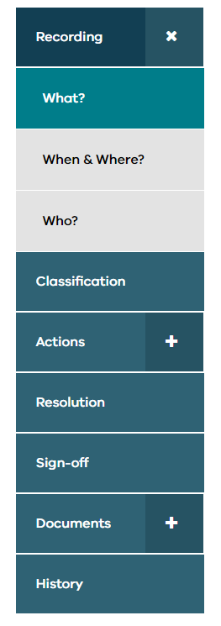
Recording feedback
Answer questions for:
What?
When & Where?
Who?
The wizard along the side will show your progress
Whenever you select , the feedback will be saved to your dashboard. There are no drafts.
Mandatory fields are marked with an asterisk (*).
Choose for tool tips and more information about questions throughout the system.

Slide 21
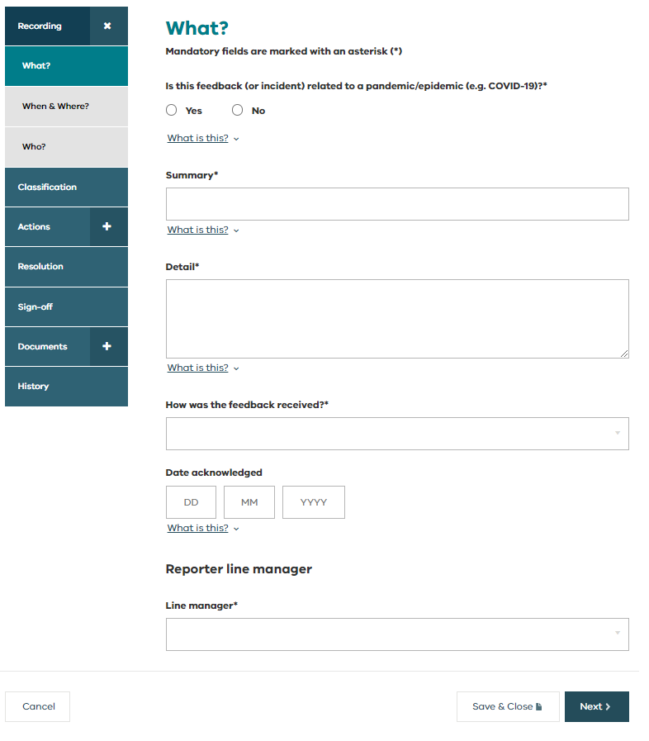
Recording feedback – what?
Enter information about the feedback:
Note if the feedback is related to a pandemic/epidemic (e.g. COVID-19)
Description of the feedback received
How it was received
Date acknowledged (dependent upon your local processes).
Select the line manager you would like to receive the feedback.

Slide 22
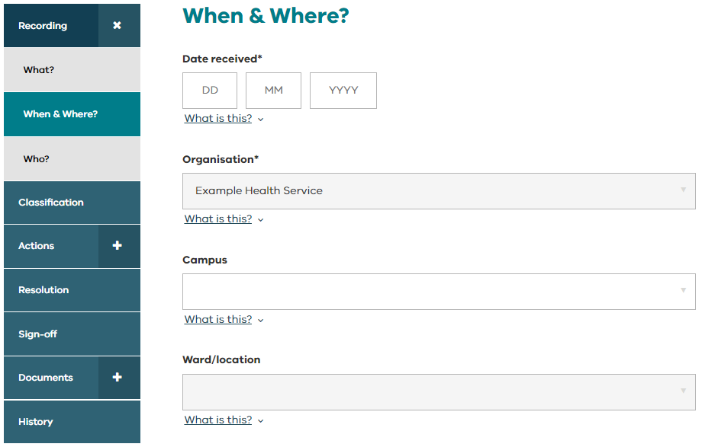
Recording feedback – when & where?
Date received is the date the health service received the feedback.
Select the most appropriate locations related to the feedback.
These dropdown options have been configured by your organisation.
If the feedback includes issues for multiple locations at your health service, create a new feedback for each location.

Slide 23
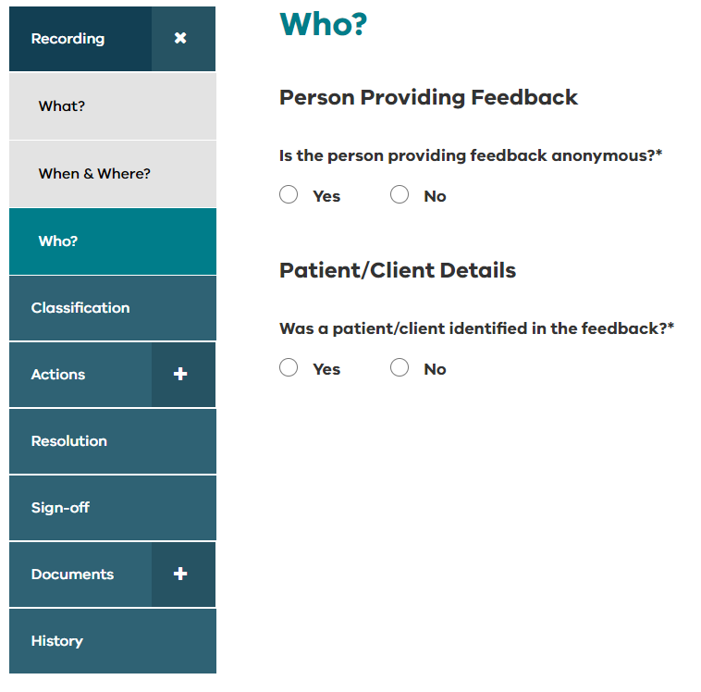
Recording feedback – who?
Enter information about the person providing the feedback (can be provided anonymously).
If a patient/client is identified in the feedback, the complainant’s relationship to the patient/client must be specified.

Slide 24
Classification
Classification

Slide 25
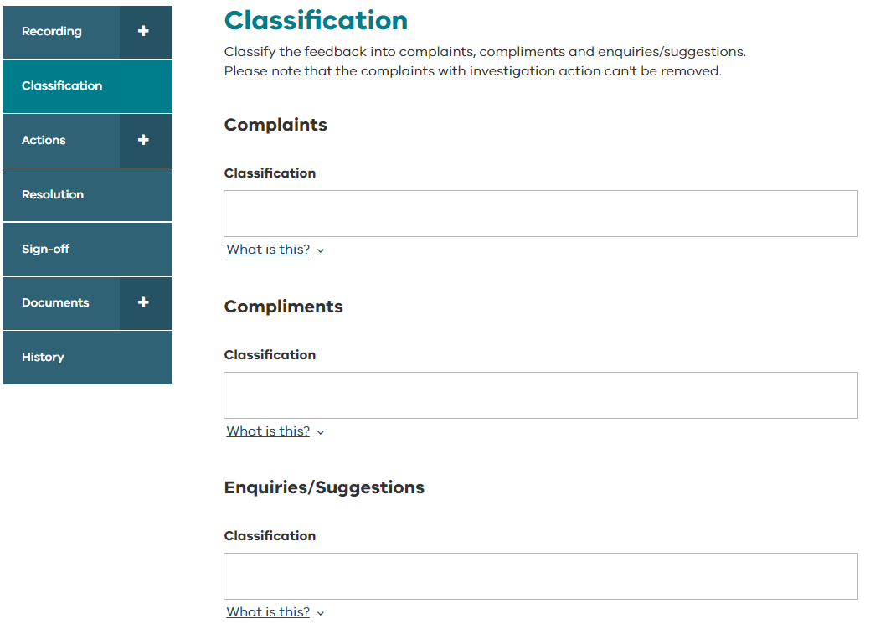
Classification
Classify the feedback into complaints, compliments and enquiries / suggestions.
A feedback record may contain more than one type.
On the feedback dashboard you can easily see the feedback type with these symbols:
Complaint
Compliment
Enquiries/Suggestions

Slide 26
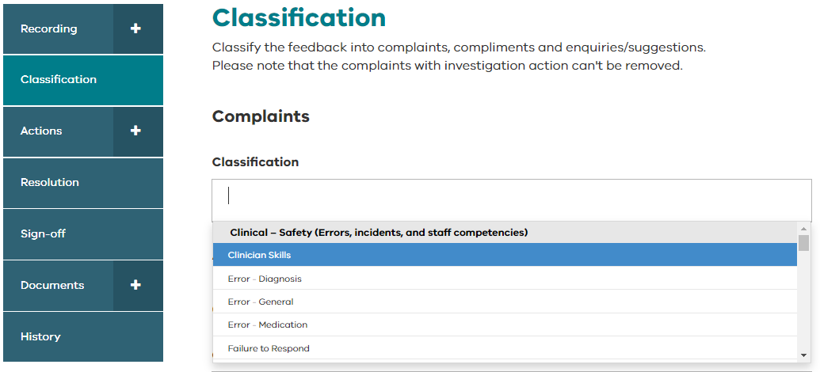
Classification - complaints
Complaint classifications are aligned to the Healthcare Complaints Analysis Tool (HCAT).
The HCAT is a validated tool that categorises complaints according to:
Domain
Category
Subcategory

Slide 27
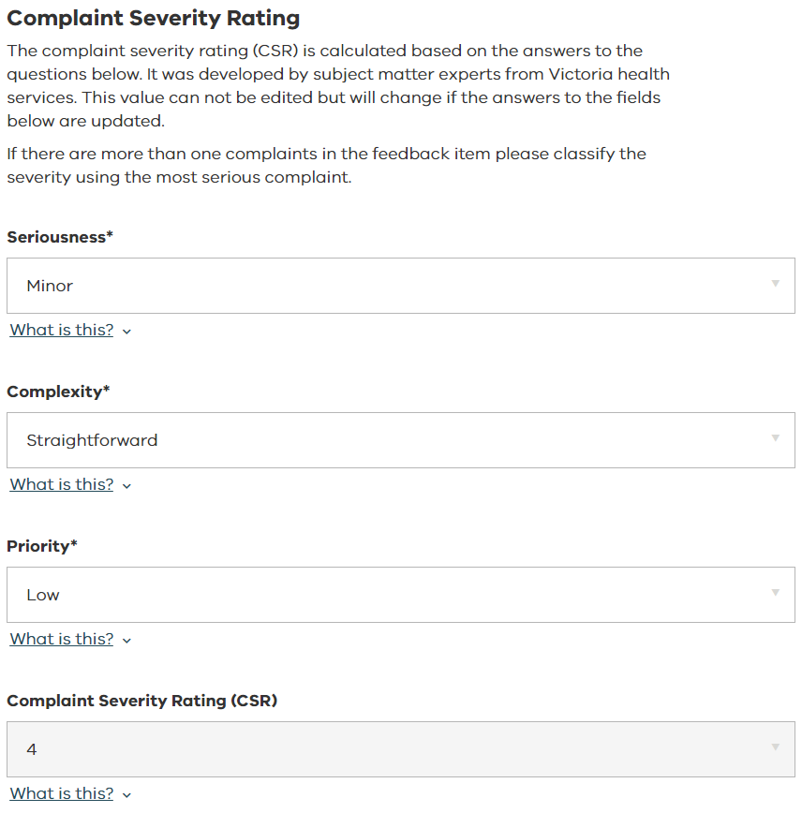
Classification – complaint severity rating
The complaint severity rating (CSR) will be calculated automatically based on your answers to these questions:
seriousness
complexity
priority
If there are more than one complaints in the feedback item, please classify the severity using the most serious complaint.

Slide 28
Feedback actions
Feedback actions

Slide 29
Feedback actions - definitions
The different actions available for feedback are investigations, tasks, and recommendations:
Action | Definition
Investigation | Use the investigation action to investigate the complaints, compliments and enquiries recorded in the feedback. When you assign an investigation to a staff member, they will receive an email notification and the investigation will appear on their actions dashboard until it is complete.
Tasks | Use the task action to ask another staff member for their advice/input or assistance with the feedback. The staff member will receive an email and this task will appear on their actions dashboard until it is complete.
Recommendations | Use the recommendation action to detail and allocate recommendations that result for a review of this feedback. The staff member responsible for each recommendation will receive an email notification and this recommendation will appear on their actions dashboard until it is complete. They will also be sent reminder emails about this recommendation.

Slide 30
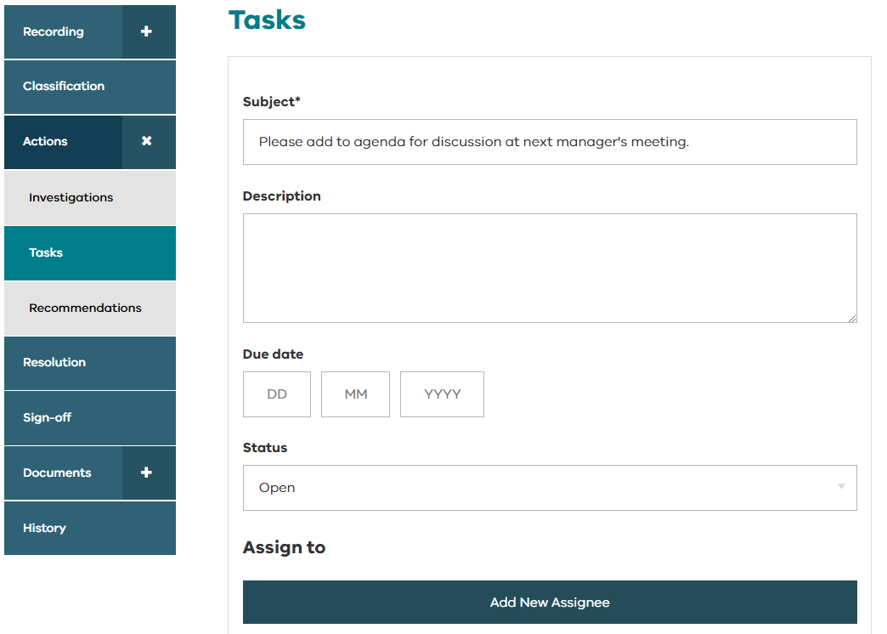
Feedback actions – adding an action
The process is similar for entering different types of actions (investigations, tasks or recommendations).
This example is for adding a new task.
select Add New Task.
complete the details.
add a due date (optional)
assign to a staff member(s)
save
Actions can only be assigned to other users with access to the feedback module.
You can add as many actions as required.
Tip! | When you assign someone an action, they will receive an email notification and the task will now appear on their actions dashboard.

Slide 31
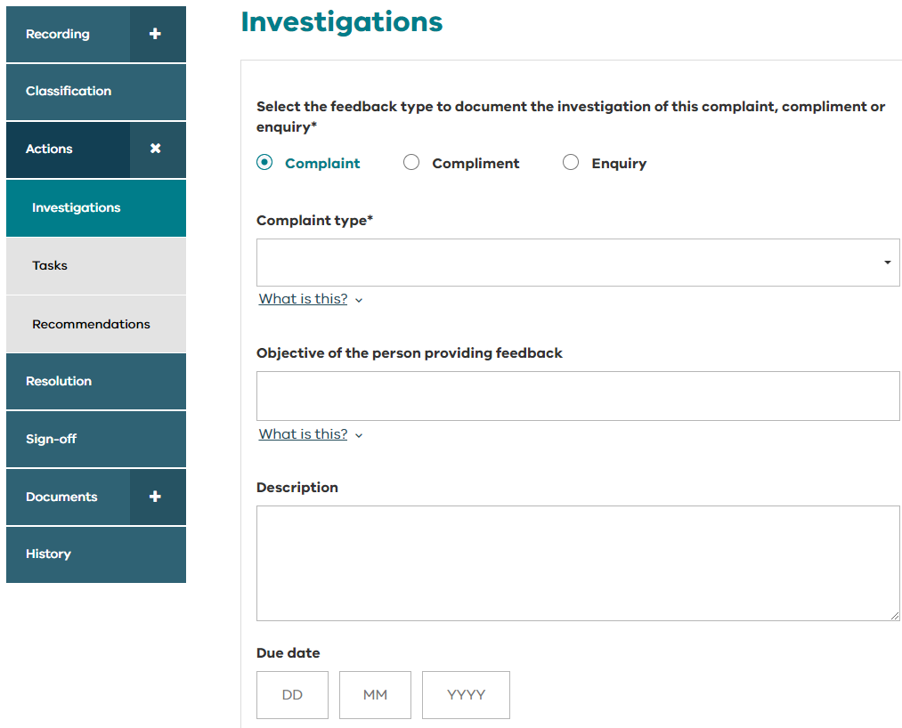
Feedback actions - investigations
Investigations can be created for complaints, compliments and enquiries.
Select the feedback type to document the investigation.
Choose the type (e.g. complaint type). The dropdown list will only show the types that were selected in the ‘Classification’ section.
If there are multiple complaint types, the investigation for each complaint type must be recorded separately.
Additional investigations can be added if required.

Slide 32
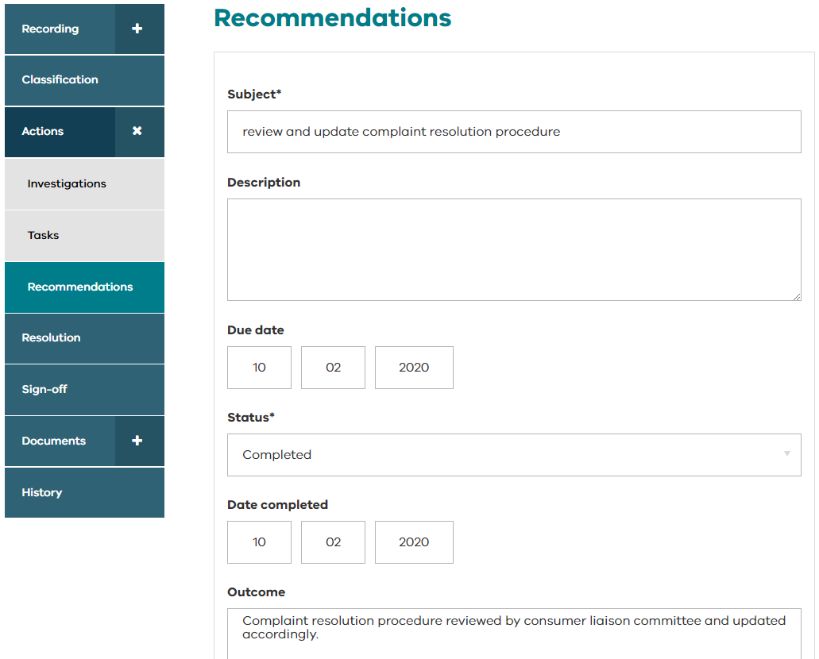
Feedback actions – recording an action for yourself
If you want to record an action that you took, simply assign it to yourself and mark it as closed when complete.

Slide 33
Resolution
Resolution

Slide 34
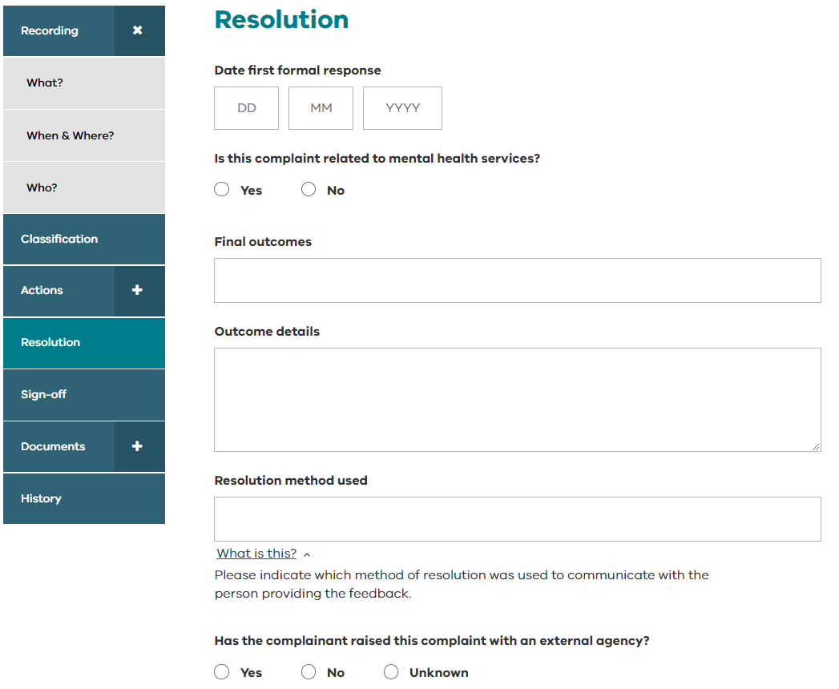
Resolution
Document the outcomes of the feedback and the resolution method used to communicate with the person providing the feedback

Slide 35
Feedback sign-off
Feedback sign-off

Slide 36
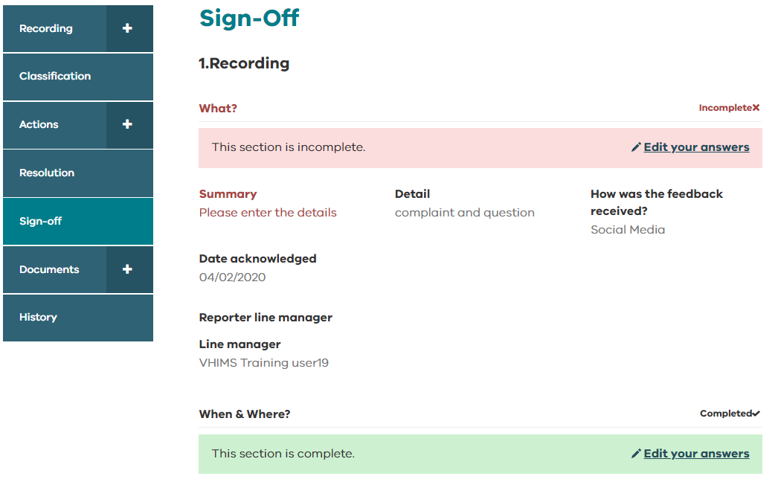
Feedback sign-off
*For Managers
This is where you sign-off a feedback record and mark it as ‘Closed’.
You can see all the information relating to the feedback on one screen.
If a section header is red it means a mandatory field is incomplete.
You will be unable to close the feedback if information is missing.
Select ‘Edit your answers’ to make changes.
You can use this same function to edit any responses you want to change before closing the feedback.

Slide 37
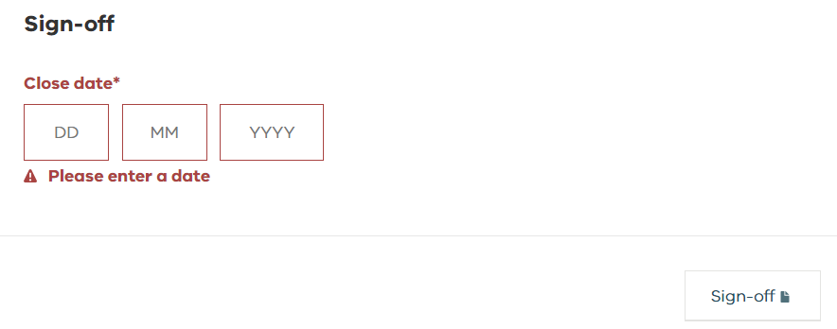
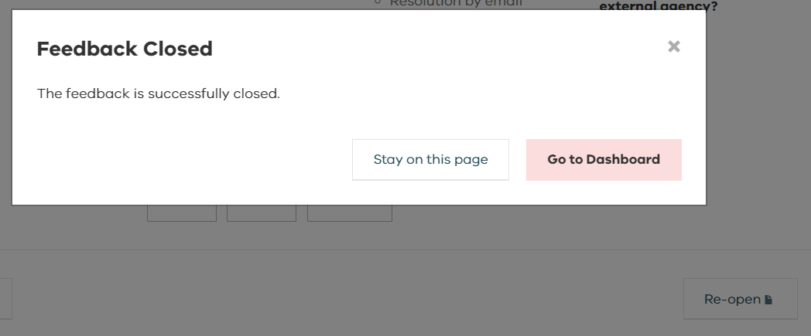
Feedback sign-off
Enter the date the feedback was closed, then select ‘Sign-off’.
You can back date the sign-off if required but the ‘Close date’ cannot be before the date the feedback was received.
You will receive the Feedback Closed message when the feedback has been closed.
The status of the feedback will change on your dashboard.

Slide 38
Feedback documents
Feedback documents

Slide 39
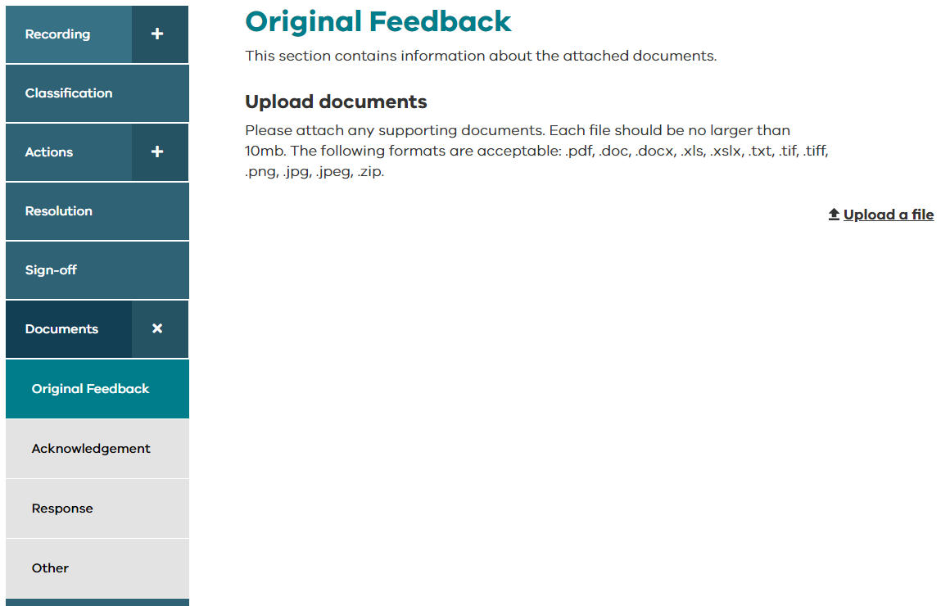
Feedback documents
Feedback documents can be uploaded according to category:
Original feedback
Acknowledgement
Response
Other
Choose ‘Upload a file’ to attach a document to the feedback record.

Slide 40
Feedback history
Feedback history

Slide 41
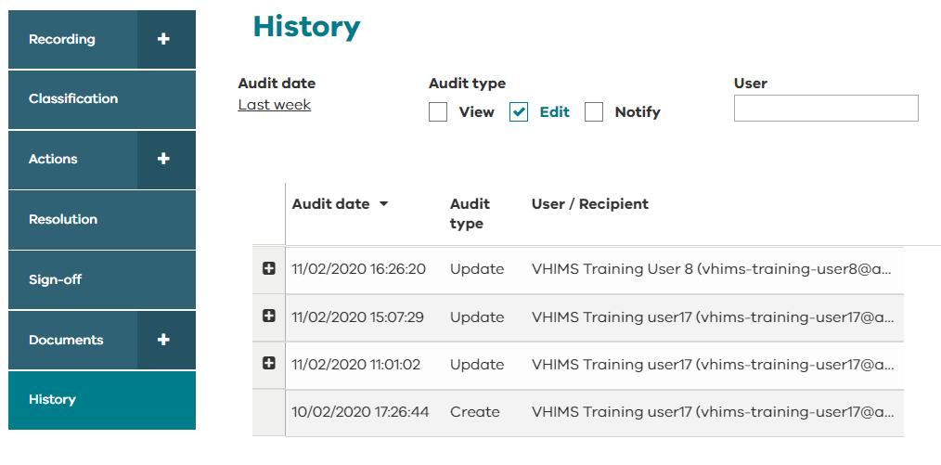
Feedback history
History shows the audit history of the feedback record.
History can be filtered by audit date, audit type, and user.
The audit history shows:
Who created the feedback
Who viewed the feedback
Who updated the feedback and details of any changes
Who was notified (includes email notifications sent to managers, reporters, teams as part of notification rules, and when any actions are assigned).
Tip! | Adjust the filters on the history page to ‘Audit date’ – show all, and select all ‘Audit types’ if you want to see the full history of the feedback.

Slide 42
Logging off
Logging off

Slide 43
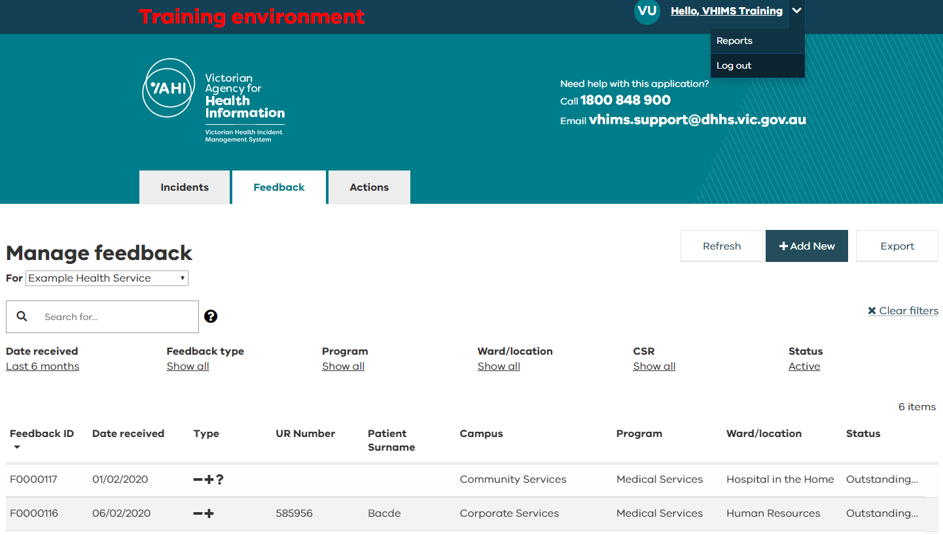
Logging off
Remember to log off the system by selecting the arrow next to your name in the top right corner and choosing ‘Log out’.
If you don’t log off, the next time you attempt to log in, you may need to log out and back in to refresh the session.

Slide 44
For further information
For further information
Contact your local VHIMS CS administrator
Contact the department: vhims2@vahi.vic.gov.au
Contact VHIMS Support using the details below:
1800 848 900
VHIMS CS education and training resources
Vhims@support.vic.gov.au

