Slide 1
VHIMS Central Solution
Consumer Experience Outcomes and Safety | December 2024
Victorian Health Incident Management System
End User Training – System roles and permissions

Slide 2
Table of contents
Select any section to go directly to that page.
1. System roles and permissions | 3
1.1 Understanding VHIMS CS roles and permissions | 4
1.2 Most common roles | 5
1.2 Overview of roles and permissions | 6
2. What do I see on my dashboards? | 7
2.1 Incidents dashboard | 8
2.2 Feedback dashboard | 9
2.3 Actions dashboard | 10
3. System administration roles | 11
4. Profile delegation | 13
5. For further information | 16

Slide 3
VHIMS CSroles and permissions
VHIMS CS roles and permissions

Slide 4
Understanding VHIMS CS roles and permissions
A user can only be assigned one role in VHIMS CS.
The system role that is assigned to a user relates to:
what sections (tabs) that they have permission to access
what they can see via their dashboards
what questions they can see/edit in the forms.
There are nine (9) available VHIMS CS roles:
Reporter
Staff
Manager
OHS manager
CLO
Risk manager
Executive
Helpdesk
Organisation admin

Slide 5
Most common VHIMS CS roles
Risk Manager
 Access to all ‘clinical’ incidents
 Limited access to ‘OHS’ incidents and hazards
 No access to administration module
Manager
 Can manage incidents and feedback
 Limited access to incidents and feedback
 No access to administration module
Reporter
 Can create incidents
 Cannot create feedback
Staff
 Can create incidents
 Can create feedback
Executive
 Highest level of system access
 Access to all incidents and feedback
 No access to administration module
Helpdesk
 Highest level of system access
 Access to all incidents and feedback
 Access to administration module
 Cannot be a line manager
These are the most commonly assigned VHIMS CS roles

Slide 6
Overview of VHIMS CS roles and permissions
 | Permissions | Reporter | Staff | Manager | OHS Manager | CLO | Risk Manager | Executive | Helpdesk | Organisation Admin
INCIDENTS | Create Incidents |  |  |  |  |  |  |  |  | 
 | View/edit OHS incidents created by another user on my behalf |  |  |  |  |  |  |  |  | 
 | View/edit incidents containing actions that are assigned to me |  |  |  |  |  |  |  |  | 
 | View/edit all incidents as routed by notification rules |  |  |  |  |  |  |  |  | 
 | View all ‘clinical’ incidents within my organisation on my incident dashboard |  |  |  |  |  |  |  |  | 
 | View all ‘OHS’ incidents and ‘Hazards’ within my organisation on my incident dashboard |  |  |  |  |  |  |  |  | 
 | View ALL incidents within my organisation on my incident dashboard |  |  |  |  |  |  |  |  | 
 | Be a line manager |  |  |  |  |  |  |  |  | 
 | Manage incidents (edit Why & How, close / re-open incidents) |  |  |  |  |  |  |  |  | 
FEEDBACK | Create Feedback |  |  |  |  |  |  |  |  | 
 | Manage feedback (close / re-open feedback) |  |  |  |  |  |  |  |  | 
 | Remove/ Restore incident and feedback records |  |  |  |  |  |  |  |  | 
 | View ALL feedback records within my organisation on my feedback dashboard |  |  |  |  |  |  |  |  | 
REPORTS | View Reports |  |  |  |  |  |  |  |  | 
 | Access Incident extract (full data extract for Incidents) |  |  |  |  |  |  |  |  | 
 | Access Feedback extract (full data extract for feedback) |  |  |  |  |  |  |  |  | 
OTHER | Access Actions |  |  |  |  |  |  |  |  | 
 | View incidents as Read/Unread on Incident, Feedback, and Actions dashboards |  |  |  |  |  |  |  |  | 
 | Access My Profile to delegate my permissions |  |  |  |  |  |  |  |  | 
 | View/edit all incidents that another user has access to, if they have delegated to me |  |  |  |  |  |  |  |  | 
 | Access the Administration module (Users, Teams, Notifications, and Organisation) |  |  |  |  |  |  |  |  | 

Slide 7
What do I see on my dashboards?
What do I see on my dashboards?

Slide 8
Which records do I see in the Incident dashboard?
As a user, which records do I see in the Incident dashboard?
All incidents created by myself or any of my subordinates (i.e. users who have myself as line manager)
All ‘OHS (Staff)’ incidents which were created by another user on my behalf or on behalf of any of my subordinates
All incidents containing actions that are assigned to me
All incidents that are routed to any of my teams (i.e. all incidents matching any of the active notification rules of any of the active teams I belong to)
If another user account has been permanently linked to my user account, I can see all incidents that the other user can see
If another user account has been temporarily delegated to my user account, I can see all incidents that the other user can see (see slides on profile delegation)
If my role is ‘Risk Manager’, I can see all ‘Clinical’ incidents within my organisation
If my role is ‘OHS Manager’, I can see all ‘OHS (Staff)’, ‘OHS (Visitor)’, and ‘Hazard’ incidents within my organisation
If my role is ‘Executive’ or ‘Helpdesk’, I can see ALL incidents within my organisation

Slide 9
Which records do I see in the Feedback Dashboard?
As a user, which records do I see in the Feedback dashboard?
All feedback records created by myself or any of my subordinates (i.e. users who have myself as line manager)
All feedback records containing actions that are assigned to me
All feedback records that are routed to any of my teams (i.e. all feedback records matching any of the active notification rules of any of the active teams I belong to)
If another user account has been permanently linked to my user account, I can see all feedback records that the other user can see
If another user account has been temporarily delegated to my user account, I can see all feedback records that the other user can see (see slides on profile delegation)
If my role is "CLO" or "RiskManager" or "Executive" or "Helpdesk", I can see all feedback records within my organisation

Slide 10
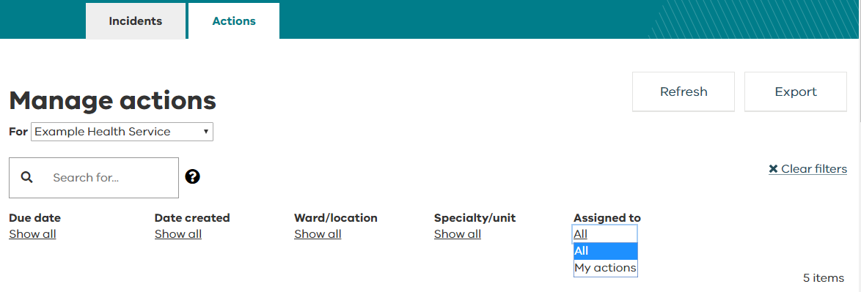
Which records do I see in the Actions Dashboard?
As a user, which records do I see in the Actions dashboard?
All outstanding actions from incidents I can see on the Incident dashboard
All outstanding actions from feedback records I can see on the Feedback dashboard
NOTES:
The Actions dashboard defaults to displaying only the actions allocated to you (i.e. "Assigned to" = "My actions")
To see all actions related to incidents and feedback records that you have access to, change the filter ‘Assigned to’ and select All

Slide 11
System administration
System administration

Slide 12
System administration roles
The administration module is how changes to your organisations users, teams, notifications and organisation are managed
There are two types of system roles available which provide access to the administration module sections: Helpdesk and Organisation Admin
Helpdesk | Provides access to organisation-wide data in the Incidents, Feedback and Actions sections of your VHIMS CS system. Provides access to the four administration module sections of: Users, Team, Notifications and Organisation. This role does not allow the user to have subordinates (users in this role cannot be line managers).
Organisation Admin | Provides access to the administration module specific sections of: Users, Teams, Notifications and Organisations. This role provides no access to create or manage incidents or feedback, it is purely a system administration role.

Slide 13
Profile delegation
Profile delegation

Slide 14
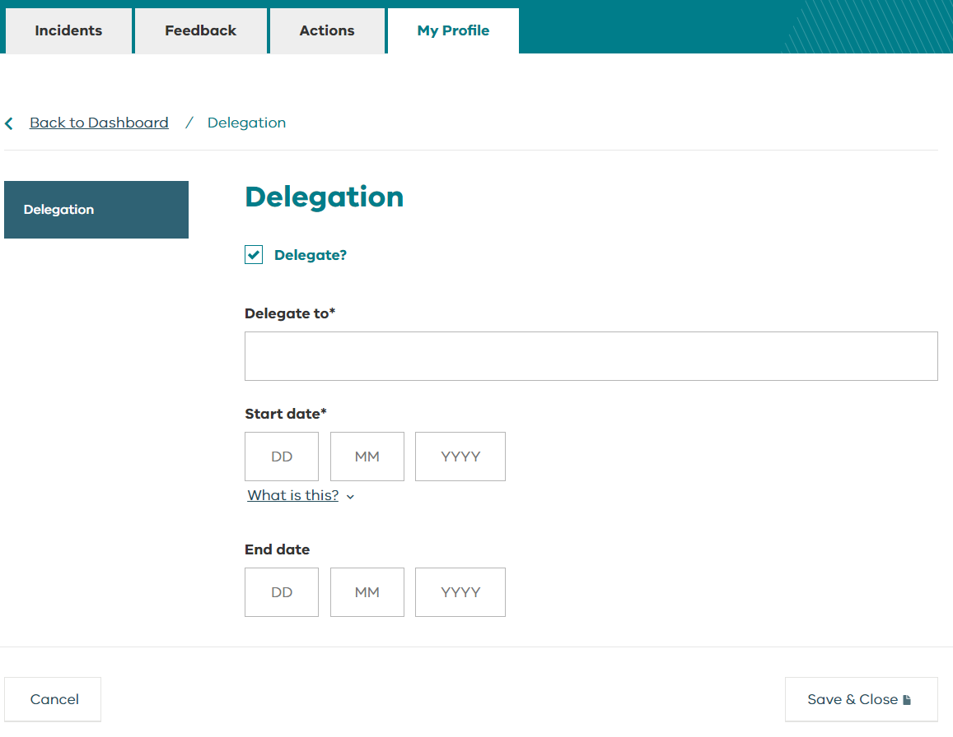
Profile delegation
My Profile module allows users with these system roles to temporarily delegate their VHIMS Central incidents and feedback to another staff member:
Manager
OHS manager
CLO
Risk manager
Executive
System administrators (Helpdesk and Organisation Admin roles) and VHIMS Support have access to manage users and are able to set up or cancel a delegation on someone’s behalf.

Slide 15
Profile delegation
If you delegate to another user (or if a system administrator delegates on your behalf), the delegated user will be able to:
receive all email notifications that you receive (you will also continue to receive notification emails while the delegation is in effect).
view all the incidents and feedback records that you see on your dashboards.
The delegated user will be able to edit the fields they can access based on their delegated system role. For example:
Reporters will have access to Feedback
Reporters and Staff will be able manage incidents (edit the ‘Why and How’ section) and close or re-open incidents and feedback.
Delegation can be created for a user even if the user status is ‘inactive’ in the system.
The system allows for chained profile delegation – the delegated user can further delegate to another person (e.g. User A can delegate to User B who can delegate to User C).

Slide 16
For further information
For further information
Contact your local VHIMS CS administrator
Contact the VHIMS team: vhims2@vahi.vic.gov.au
Contact VHIMS Support using the details below:
1800 848 900
VHIMS CS education and training resources
vhims@support.vic.gov.au

