Slide 1
VHIMS Central Solution
Consumer Experience Outcomes and Safety | December 2024
Victorian Health Incident Management System
End User Training – System Management

Slide 2
Table of contents
Select any section to go directly to that page.
1. System roles and permissions | 3
1.1 Understanding roles and permissions | 4
1.2 Most common roles | 5
1.1 Overview of roles and permissions | 6
1.2 System administration roles | 7
4. Teams | 22
4.1 Accessing teams | 23
4.2 Edit a team | 24
4.3 Deactivate/reactivate a team | 26
4.4 Adding a new team | 27
6. Organisations (continued)
6.5 Editing wards / locations | 42
6.6 Adding a new ward / location | 43
6.7 Editing specialties / units | 44
6.8 Adding a new specialty / unit | 45
6.9 Editing programs | 46
6.10 Adding a program | 47
5. Notifications | 29
5.1 Accessing notifications | 30
5.2 Edit a notification rule | 32
5.3 Deactivate/reactivate a notification rule | 34
5.4 Adding a new notification rule | 35
2. Administration dashboard | 8
7. Remove / restore records | 48
7.1 Removing & restoring records | 49
7.2 Removing incidents / feedback | 50
7.3 Restoring incidents / feedback | 51
3. Users | 10
3.1 Accessing users | 11
3.2 Transferring subordinates | 12
3.3 Edit a user | 13
3.4 Managing line managers | 15
3.5 Linking user accounts | 16
3.6 Profile delegation | 17
3.7 Deactivate/reactivate a user | 20
3.8 Adding a new user | 21
6. Organisations | 37
6.1 Managing organisation details | 38
6.2 Authorising officers | 39
6.3 Managing campus details | 40
6.4 Managing wards / locations | 41
8. System Reporting | 52
9. Logging off | 54
10. For further information | 56
Notes:
11

Slide 3
Roles and permissions
VHIMS CS roles and permissions

Slide 4
Understanding VHIMS CS system roles and permissions
A user can only be assigned one VHIMS CS system role.
The system role that is assigned to a user relates to:
what sections (tabs) that they have permission to access
what they can see via their dashboards
what questions they can see/edit in the forms*.
There are nine (9) available VHIMS CS roles:
Reporter
Staff
Manager
OHS manager
CLO
Risk manager
Executive
Helpdesk
Organisation admin
*Refer to the Roles and Permissions resource for more information.

Slide 5
Most common VHIMS CS roles
Risk Manager
 Access to all ‘clinical’ incidents
 Limited access to ‘OHS’ incidents and hazards
 No access to administration module
Manager
 Can manage incidents and feedback
 Limited access to incidents and feedback
 No access to administration module
Reporter
 Can create incidents
 Cannot create feedback
Staff
 Can create incidents
 Can create feedback
Executive
 Highest level of system access
 Access to all incidents and feedback
 No access to administration module
Helpdesk
 Highest level of system access
 Access to all incidents and feedback
 Access to administration module
 Cannot be a line manager
These are the most commonly assigned VHIMS CS roles

Slide 6
Overview of VHIMS CS roles and permissions
 | Permissions | Reporter | Staff | Manager | OHS Manager | CLO | Risk Manager | Executive | Helpdesk | Organisation Admin
INCIDENTS | Create Incidents |  |  |  |  |  |  |  |  | 
 | View/edit OHS incidents created by another user on my behalf |  |  |  |  |  |  |  |  | 
 | View/edit incidents containing actions that are assigned to me |  |  |  |  |  |  |  |  | 
 | View/edit all incidents as routed by notification rules |  |  |  |  |  |  |  |  | 
 | View all ‘clinical’ incidents within my organisation on my incident dashboard |  |  |  |  |  |  |  |  | 
 | View all ‘OHS’ incidents and ‘Hazards’ within my organisation on my incident dashboard |  |  |  |  |  |  |  |  | 
 | View ALL incidents within my organisation on my incident dashboard |  |  |  |  |  |  |  |  | 
 | Be a line manager |  |  |  |  |  |  |  |  | 
 | Manage incidents (edit Why & How, close / re-open incidents) |  |  |  |  |  |  |  |  | 
FEEDBACK | Create Feedback |  |  |  |  |  |  |  |  | 
 | Manage feedback (close / re-open feedback) |  |  |  |  |  |  |  |  | 
 | Remove/ Restore incident and feedback records |  |  |  |  |  |  |  |  | 
 | View ALL feedback records within my organisation on my feedback dashboard |  |  |  |  |  |  |  |  | 
REPORTS | View Reports |  |  |  |  |  |  |  |  | 
 | Access Incident extract (full data extract for Incidents) |  |  |  |  |  |  |  |  | 
 | Access Feedback extract (full data extract for feedback) |  |  |  |  |  |  |  |  | 
OTHER | Access Actions |  |  |  |  |  |  |  |  | 
 | View incidents as Read/Unread on Incident, Feedback, and Actions dashboards |  |  |  |  |  |  |  |  | 
 | Access My Profile to delegate my permissions |  |  |  |  |  |  |  |  | 
 | View/edit all incidents that another user has access to, if they have delegated to me |  |  |  |  |  |  |  |  | 
 | Access the Administration module (Users, Teams, Notifications, and Organisation) |  |  |  |  |  |  |  |  | 

Slide 7
System administration roles
The administration module allows you to manage changes to your organisation’s users, teams, notification rules and organisation details.
There are two types of system roles available which provide access to the administration module: Helpdesk and Organisation Admin.
Helpdesk | Provides access to organisation-wide data in the Incidents, Feedback and Actions sections of your VHIMS CS system. Provides access to the four administration module sections of: Users, Team, Notifications and Organisation. This role does not allow the user to have subordinates (users in this role cannot be line managers).
Organisation Admin | Provides access to the four administration module sections of: Users, Team, Notifications and Organisation. This role provides no access to create or manage incidents or feedback, it is purely a system administration role.

Slide 8
Administration module dashboard
Administration module dashboard

Slide 9
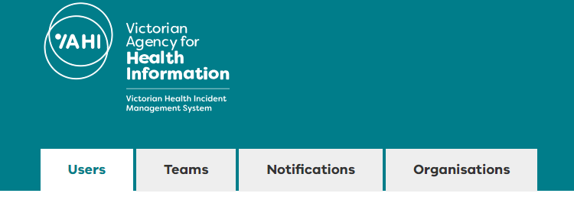
Administration module dashboard
If you have a system administration role, you will see these tabs when you log in to your VHIMS CS system:
Users
Teams
Notifications
Organisations
These administration sections allow you to make changes to your users, team structures, notification rules, and organisational set up within your VHIMS CS system.
Tip! | If your system role is Helpdesk, you will also see tabs for Incidents, Feedback, and Actions, in addition to these four administration sections.

Slide 10
Users
Users

Slide 11
Accessing users
The Users dashboard allows you to view, edit, deactivate or reactivate your users.
You can search for users via the ‘Search’ box, as well as by filtering by ‘Active’ (yes, no, show all) and ‘Role’ (all listed and show all).
Use the ‘Export’ feature to export a list of all VHIMS CS users for your organisation.

Slide 12
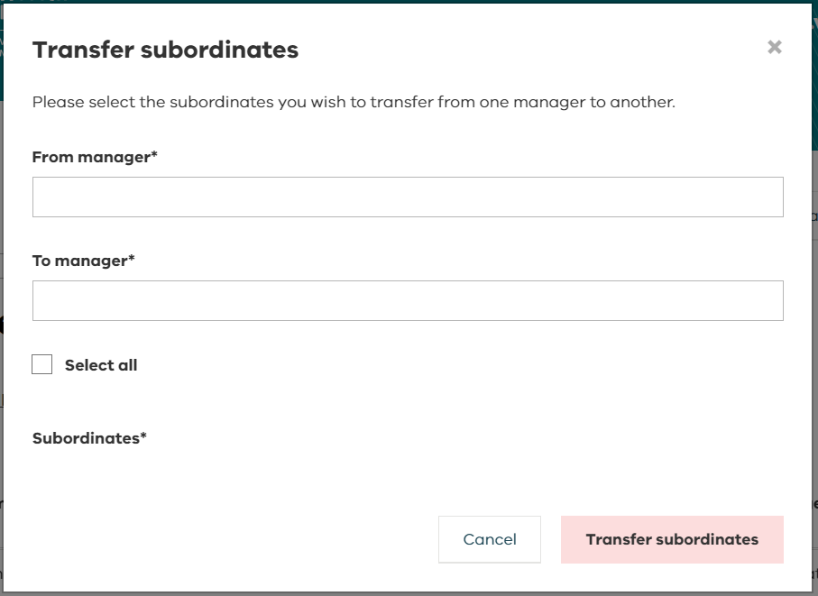
Users – transferring subordinates
From the Users dashboard, you can also transfer subordinates between existing users.
A window will pop up when you select ‘Transfer Subordinates’.
Start typing the names of the ‘From manager’ and ‘To manager’ in the boxes and a dropdown list will appear.
Select which subordinates you’d like to transfer or choose ‘Select all’.
Click ‘Transfer subordinates’ to save the transfer.
‘Transfer subordinates’ can only be used to transfer a user to one manager. Refer to managing line managers if multiple managers are required for one user.

Slide 13
Users – edit a user
To edit an existing user, double click or hover over the user you wish to amend and click on Edit.

Slide 14
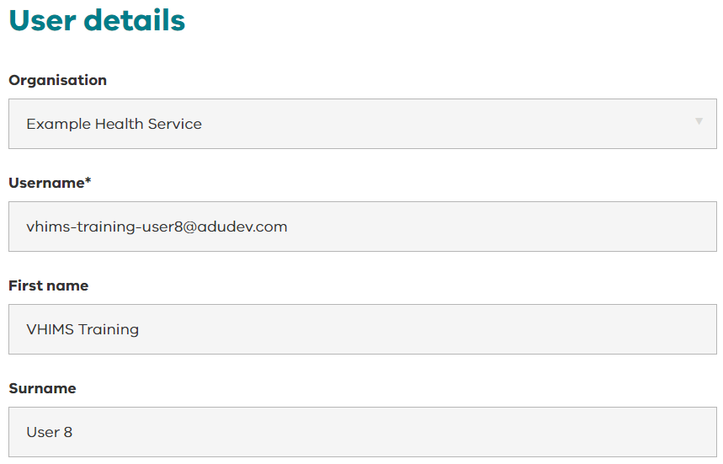
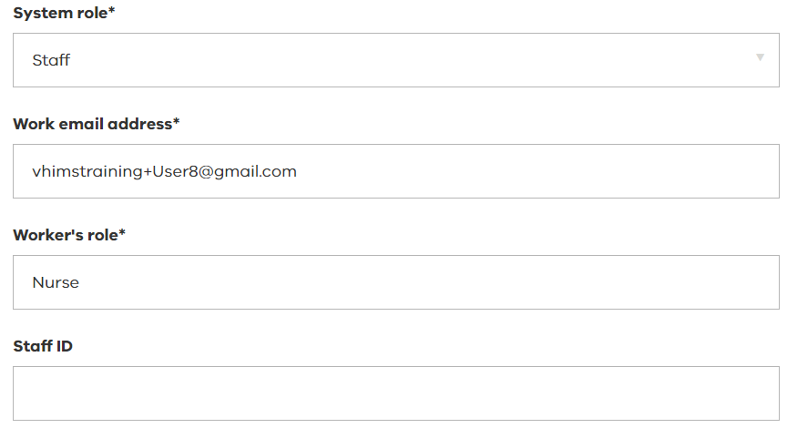
Users – edit a user
The following user details are editable:
System role
Worker’s role
Staff ID
Make the desired changes and select from the bottom right side of the page.
Contact VHIMS Support to make changes to:
Username
First name
Surname
Work email address (this field is technically editable but should only be changed through VHIMS support).

Slide 15
Users – managing line managers
To delete a user’s line manager, select ‘Delete’.
To add a line manager, select ‘Add Line Manager’.
Start typing the name of the manager you want to add.
Your search will only display users whose roles allow them to be a line manager in the system.
Select ‘Save’ to save your changes.
Note: when logging an incident, users can select from any line manager in the system so it is not necessary to add every potential manager in this section.

Slide 16
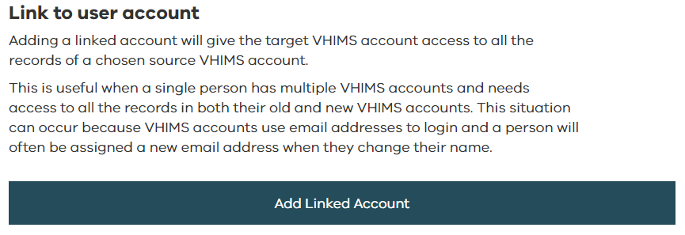
Users – linking user accounts
Add a linked account when someone has a name change and new email address. This will enable them to access all the records in both their old and new accounts.
Select ‘Add Linked Account’.
Start typing the name of the account you want to link and a list will appear.
Select ‘Save’ to save your changes.

Slide 17
Users - profile delegation
If you delegate to another user (or if a system administrator delegates on your behalf), the delegated user will be able to:
receive all email notifications that you receive (you will also continue to receive notification emails while the delegation is in effect).
view all the incidents and feedback records that you see on your dashboards.
The delegated user will be able to edit the fields they can access based on their delegated system role. For example:
Reporters will have access to Feedback
Reporters and Staff will be able manage incidents (edit the ‘Why and How’ section) close or re-open incidents and feedback.
Delegation can be created for a user even if the user status is ‘inactive’ in the system.
The system allows for chained profile delegation – the delegated user can further delegate to another person (e.g. User A can delegate to User B who can delegate to User C).

Slide 18
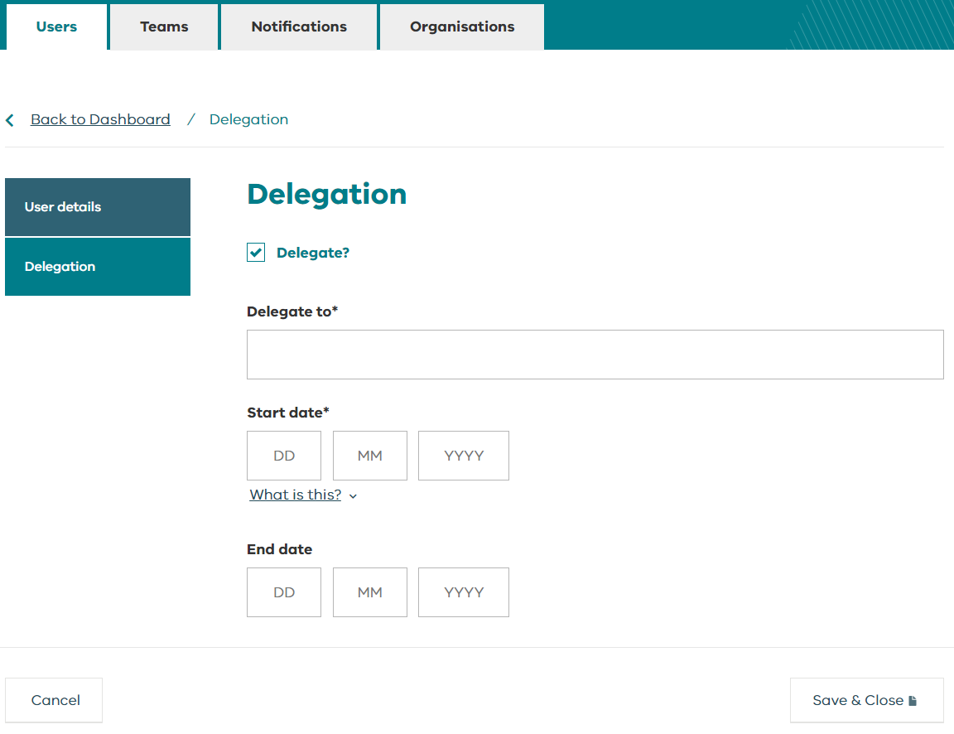
Users - profile delegation
From the Users section, you can also manage delegation.
Delegation allows users with these system roles to temporarily delegate their VHIMS CS incidents and feedback to another staff member:
Manager
OHS manager
CLO
Risk manager
Executive
System administrators (Helpdesk and Organisation Admin roles) and VHIMS Support have access to manage users and are able to set up or cancel a delegation on someone’s behalf.

Slide 19
Users - profile delegation
Check the box to ‘Delegate?’.
Start typing the name of who the user would like to delegate to in the ‘delegate to’ field.
Delegation can only be for a period of time – enter a start date (the start date must be greater than today)
Enter an end date (if known). If an end date is not specified it will be an ongoing delegation.
Select to save your changes
To cancel a delegation, de-select the box ‘Delegate?’
Tip! | A user can only have one delegation. If you can’t find their name in the ‘Delegate to’ field, they may have already been delegated to by another user.

Slide 20
Users – deactivate / reactivate a user
Note: It’s preferred that user account deactivations or reactivations are managed through the VHIMS support team.
In order to remove / deactivate/ or reactivate system users, complete the VHIMS Central user maintenance form and contact the VHIMS support team. .
Only the VHIMS CS Authorised Delegates can log a user maintenance form.
Access the VHIMS Central User Maintenance form here: https://vahi.vic.gov.au/ourwork/safety-and-surveillance-reporting/vhims-program-of-reforms/vhims-central-solution.
To contact VHIMS Central Support, email: vhims@support.vic.gov.au or call: 1800 848 900
If you deactivate a user, they will be unable to access the VHIMS CS system.

Slide 21
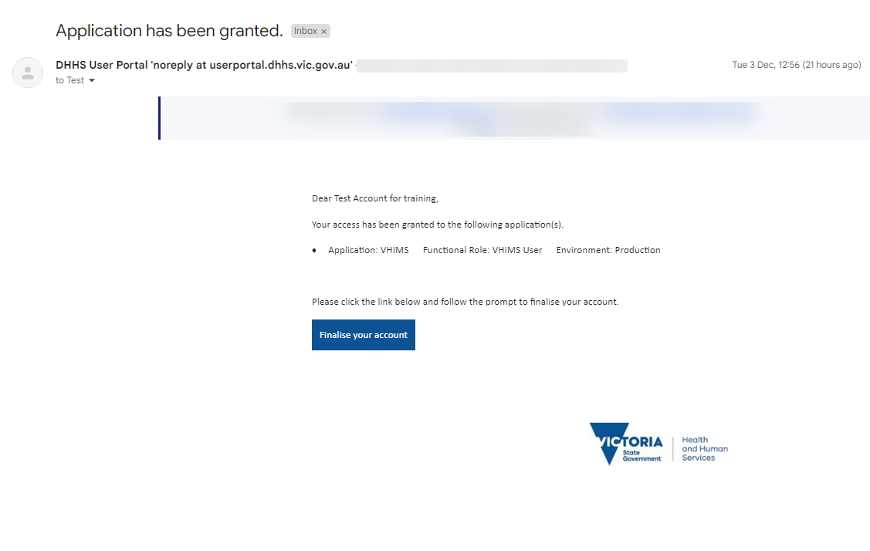
Users – adding a new user
To add a new user to the system, only VHIMS CS Authorised Delegates can log a request :
Complete the VHIMS Central user maintenance form with the new user details and line manager information.
Email the form to the VHIMS Support.
Once VHIMS Support have created the new user account, the staff member will receive an email invitation promoting them to finish setting up their account.
Note: VHIMS CS allows for users to work across multiple organisations. Contact VHIMS Support for assistance if this feature is required.
Tip! | Staff often mistake this invitation as junk mail. Please ensure you communicate to the staff member that this will be arriving, and that they will need to follow the prompts to set up their accounts.

Slide 22
Teams
Teams

Slide 23
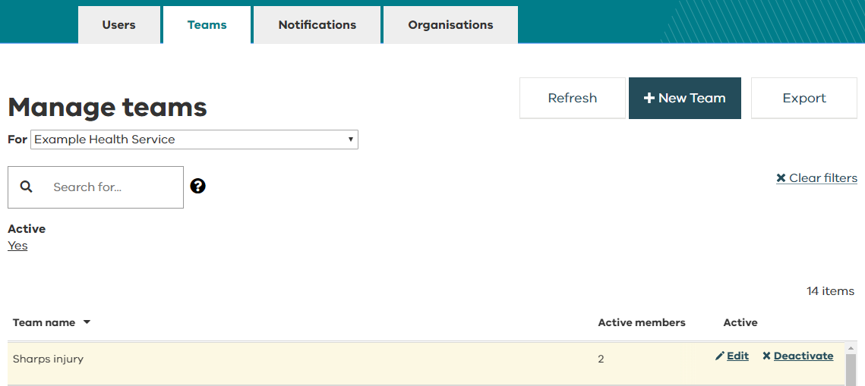
Accessing teams
The Teams dashboard allows you to view, edit, deactivate or reactivate your teams.
Team members will receive email notifications as per the notification rules your organisation has set up
You can search for teams via the ‘Search’ box, as well as by filtering by ‘Active’ (yes, no, show all).
Use the ‘Export’ feature to export a list of all VHIMS CS teams for your organisation.

Slide 24
Teams – edit a team
To edit an existing team, double click or hover over the team you wish to amend and click on Edit.

Slide 25
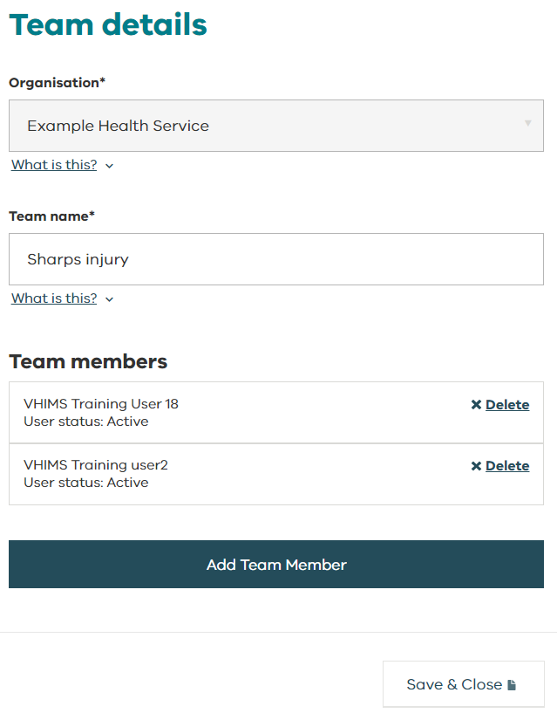
Teams – edit a team
These team details are editable:
Team name
Team members (add / delete)
Make the desired changes and select from the bottom right side of the page.
Tip! | ‘Teams’ are independent of your organisational structure. Set up your teams to reflect who needs to be notified of particular incidents or feedback.

Slide 26
Teams – deactivate / reactivate a team
From the Teams dashboard, you can deactivate or reactivate teams.
If you deactivate a team, they will no longer receive any associated notifications.
To deactivate a team, double click or hover over the team you wish to amend and select Deactivate.
A pop-up will ask you to confirm that you want to deactivate this team.
Follow the same steps to Reactivate a team. You may need to adjust the ‘Active’ filter to ‘Show all’ or ‘No’ to see the inactive teams.

Slide 27
Teams – adding a new team
To add a new team, select + New Team from the top right-hand side of the dashboard.

Slide 28
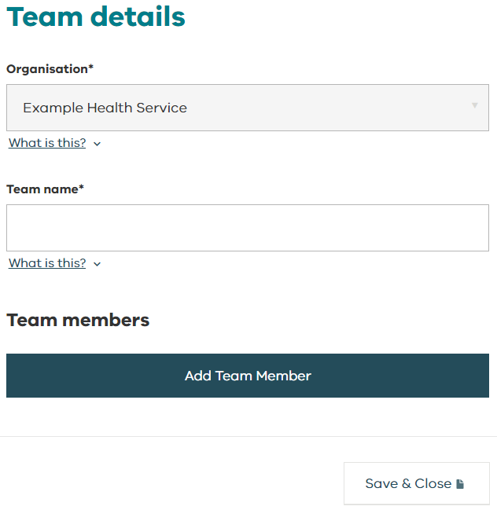
Teams – adding a new team
Enter a team name.
Add team members.
Start typing the name of the user and a dropdown list will appear.
The user must be in the system in order to be added to a team.
Save the team member.
Select to save your new team.

Slide 29
Notifications
Notifications

Slide 30
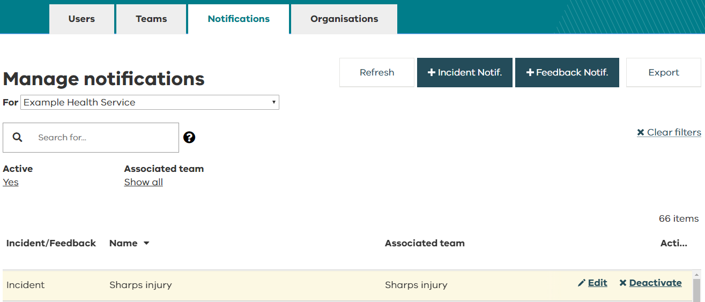
Accessing notifications
Notification rules can be created for incidents and feedback.
Create a notification rule and select which team(s) should be notified.
When an incident or feedback meets the notification criteria, the members of the team(s) associated to the notification rule will receive an email notification.
The incident will also be visible on their incident or feedback dashboard.
When permissions are delegated to another user, the delegated user will receive these email notifications.

Slide 31
Accessing notifications
The Notifications dashboard allows you to view, edit, deactivate or reactivate your notification rules for incidents and feedback
You can search for notification rules via the ‘Search’ box, as well as by filtering by ‘Active’ (yes, no, show all) or ‘Associated team’
Use the ‘Export’ feature to export a list of all VHIMS Central notification rules for your organisation

Slide 32
Notifications – edit a notification rule
To edit an existing notification rule, double click or hover over the notification you wish to amend and click on Edit.

Slide 33
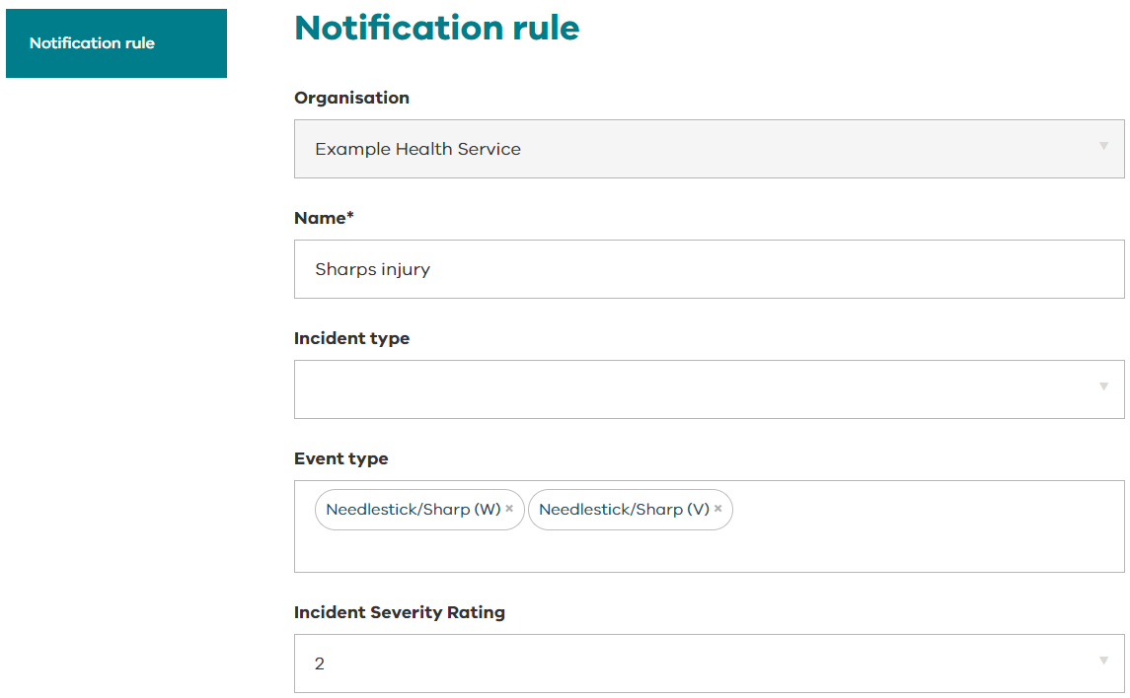
Notifications – edit a notification rule
You can edit any field related to the notification rule
You can also add new existing teams to this notification and delete teams which have been associated to the notification.
Make the desired changes and select from the bottom right side of the page.

Slide 34
Notifications – deactivate / reactivate a notification rule
From the Notifications dashboard, you can deactivate or reactivate notification rules.
If you deactivate a notification rule, the members of the associated teams will no longer receive an email notification.
To deactivate a notification rule, double click or hover over the notification you wish to amend and select Deactivate.
A pop-up will ask you to confirm that you want to deactivate this notification.
Follow the same steps to Reactivate a notification. You may need to adjust the ‘Active’ filter to ‘Show all’ or ‘No’ to see the inactive notification rules.

Slide 35
Notifications – adding a new notification rule
To add a new notification rule for incidents or feedback, select + Incident Notif. (incidents) or + Feedback Notif. (feedback) from the top right-hand side of the dashboard.

Slide 36
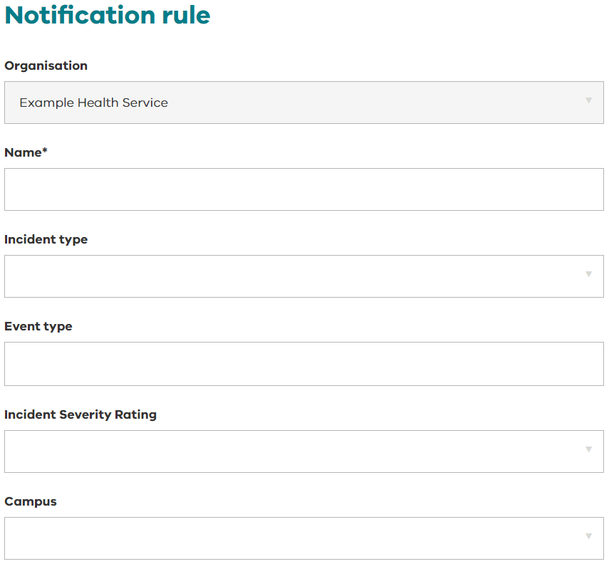
Notifications – adding a new notification
Enter a notification rule name.
You can create notification rules for any of the fields listed.
The fields are different if you are creating a notification for incidents or feedback.
Complete only the fields that are relevant to the notification rule you want to create.
Add the associated teams who should receive these notifications.
Start typing the team name and a dropdown list will appear.
Select to save your new notification rule.
Tip! | Ensure the team is created before you add a new notification rule.

Slide 37
Organisation tab
Organisations

Slide 38
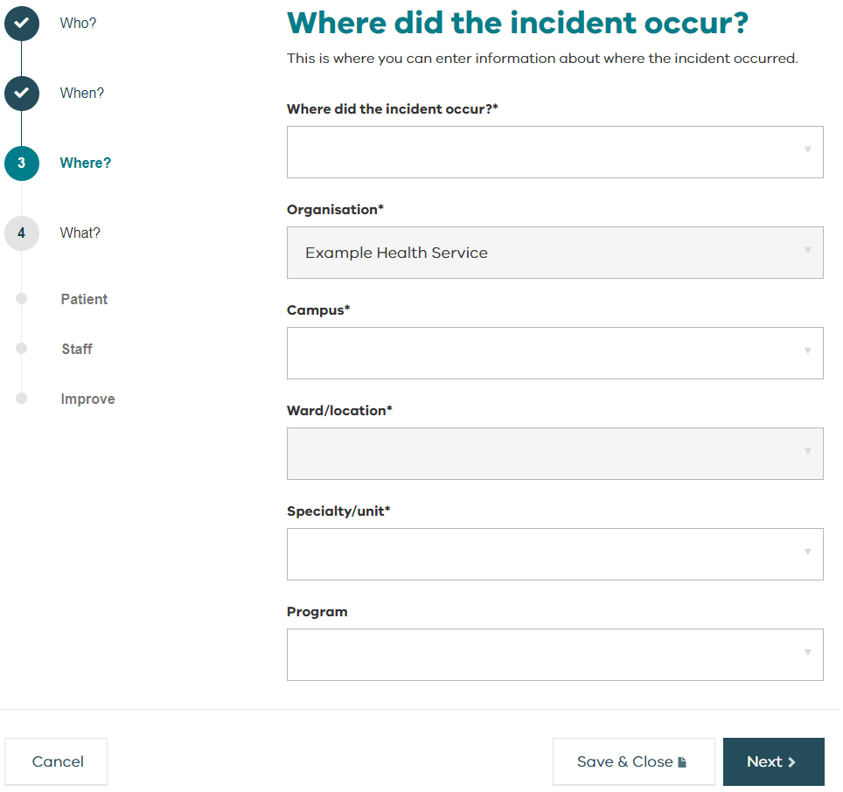
Organisations – managing organisation details
From the ‘Organisations’ tab, you can manage certain organisation details including:
Authorising officers
Wards/locations
Specialty/units
Programs.
These lists determine what users will see when they complete the ‘Where’ page for incidents and feedback.
To make any changes to your organisation name, contact VHIMS Central Support.

Slide 39
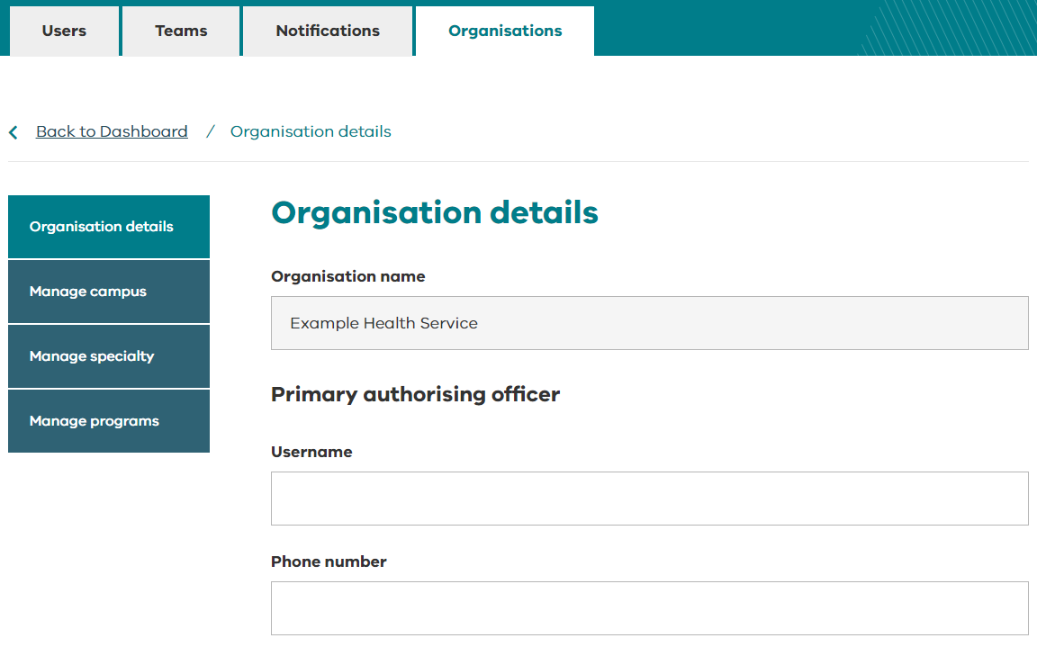
Organisations – authorising officers
The ‘Organisations’ tab opens on the ‘Organisation details’ page.
The primary and secondary authorising officers are required to approve changes to your system when they are requested through the VHIMS Central Helpdesk.
To edit the organisation’s authorising officers, start typing the username and select the desired user from the list.
Phone number is optional.
Select to save your authorising officers.

Slide 40
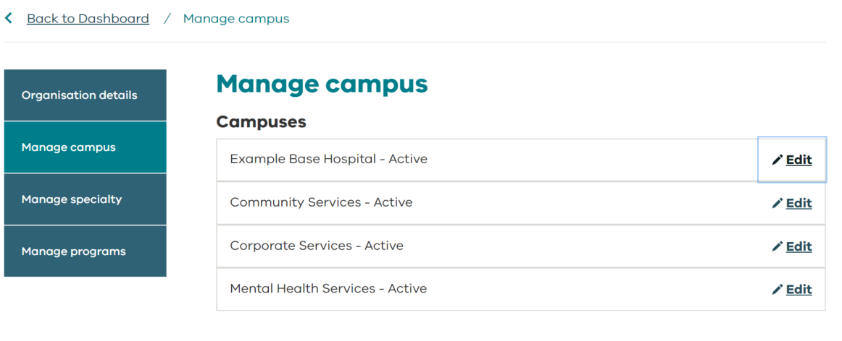
Organisations – managing campus details
From the menu on the left pane, select ‘Manage campus’.
Note: Any changes to these campus details must be made through VHIMS Central Support:
Campus name
Campus address
Add a new campus
Deactivate a campus.
One of your organisation’s listed authorising officers will need to approve requested system changes.
An ‘Inactive’ status means the campus isn’t active yet, or it has been deleted.

Slide 41
Organisations – managing wards/locations
From the menu on the left pane, select ‘Manage campus’.
Hover over the campus name and select ‘Edit’ to edit to add new wards/locations within an existing campus.

Slide 42
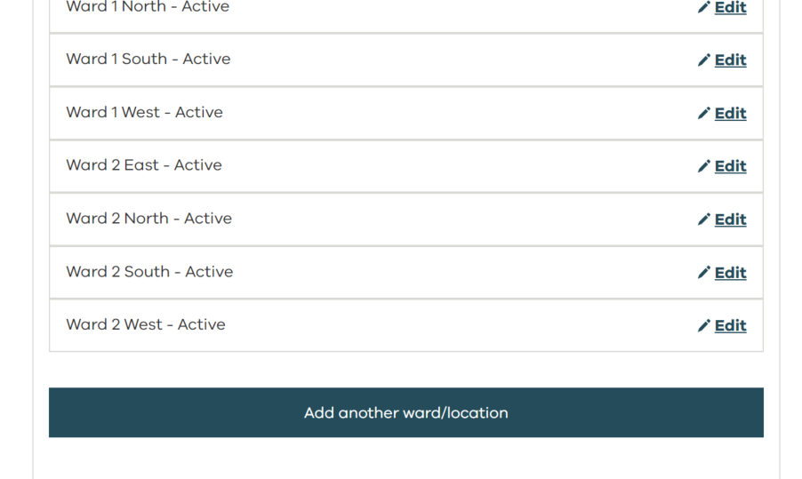
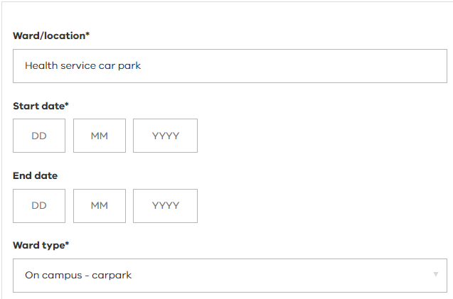
Organisations – adding a new ward/location
Within the manage campus tab, you can also add new ward/locations.
Select the ‘Add another ward/location’ button.
Enter a name for the new ward/location.
The ‘Start date’ must be greater than today.
‘End date’ is not required.
Choose the appropriate ward type
Save all changes.

Slide 43
Organisations – editing wards/locations
From the ‘Manage campus page, hover over the ward/location name and select ‘Edit’.
You can edit the ward/location name.
To delete a ward/location, enter an ‘End date’.
The ‘End date’ cannot be backdated.
An ‘Inactive’ status means the ward/location isn’t active yet.
Make sure to select ‘Save’ any changes.

Slide 44
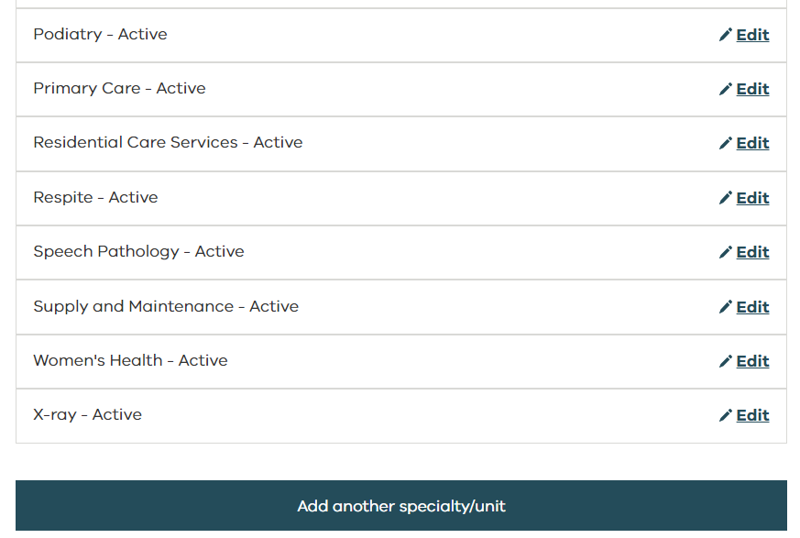
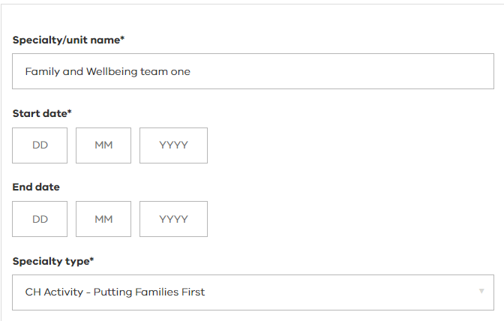
Organisations – adding a new specialty/unit
Within the manage specialty tab, you can also add new specialties/units.
Select the ‘Add another specialty/unit’ button.
Enter a name for the new specialty/unit.
The ‘Start date’ must be greater than today.
‘End date’ is not required.
Save all changes.

Slide 45
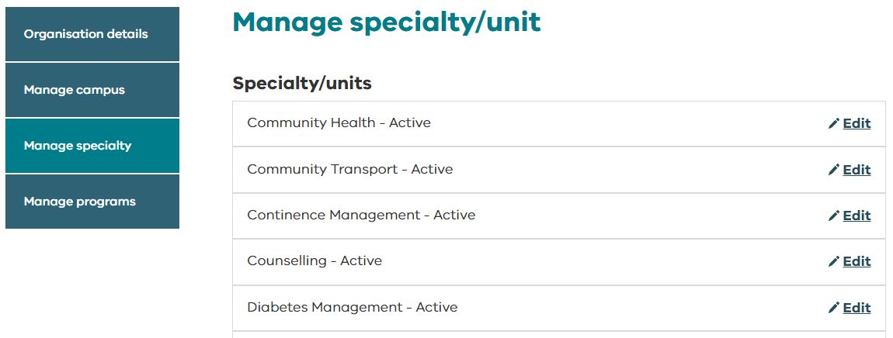
Organisations – editing specialties/units
From the menu on the left pane, select ‘Manage specialty’.
Hover over the specialty/unit name and select ‘Edit’.
A newly created specialty unit will appear with an ‘Inactive’ status prior to the start date
You can edit the specialty/unit name.
To delete a specialty/unit, enter an ‘End date’.
The ‘End date’ cannot be backdated.
Choose the appropriate Specialty Type
Make sure to select ‘Save’ any changes.

Slide 46
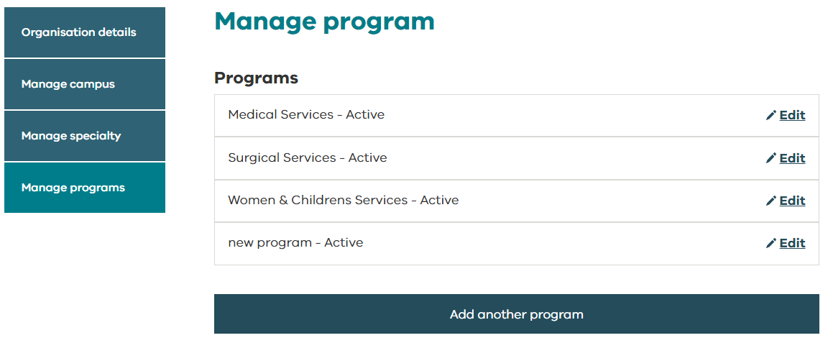
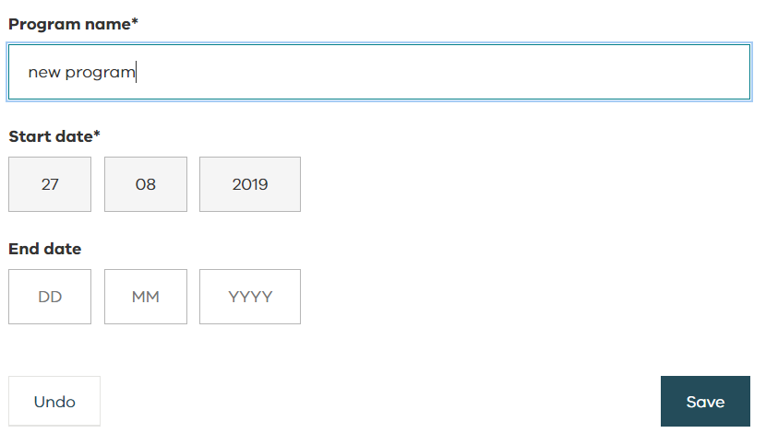
Organisations – editing programs
From the menu on the left pane, select ‘Manage programs’.
Hover over the program name and select ‘Edit’.
An ‘Inactive’ status means the program isn’t active yet.
You can edit the program name.
To delete a program, enter an ‘End date’.
The ‘End date’ cannot be backdated.
Make sure to select ‘Save’ any changes.

Slide 47
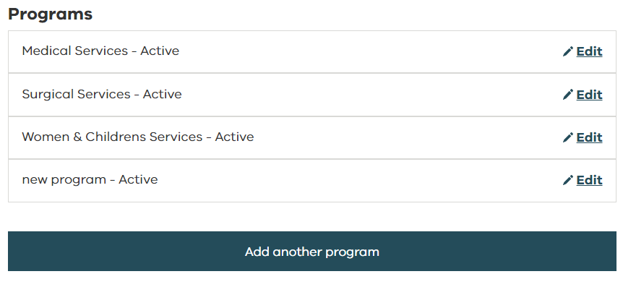
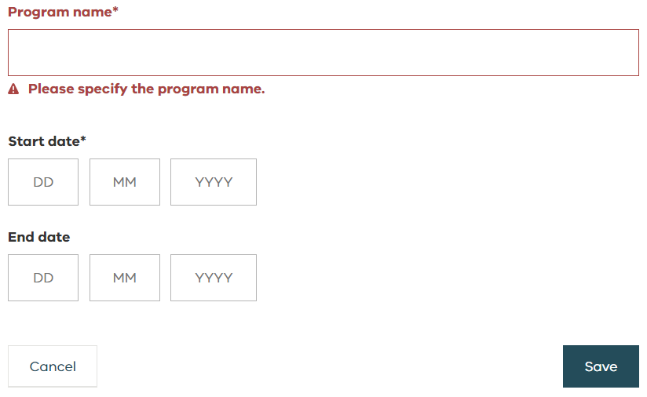
Organisations – adding a program
Within the manage programs tab, you can also add new programs.
Select the ‘Add another program’ button.
Enter a name for the new program.
The ‘Start date’ must be greater than today.
‘End date’ is not required.
Save all changes.

Slide 48
Remove/Restore incidents and feedback
Removing and restoring records

Slide 49
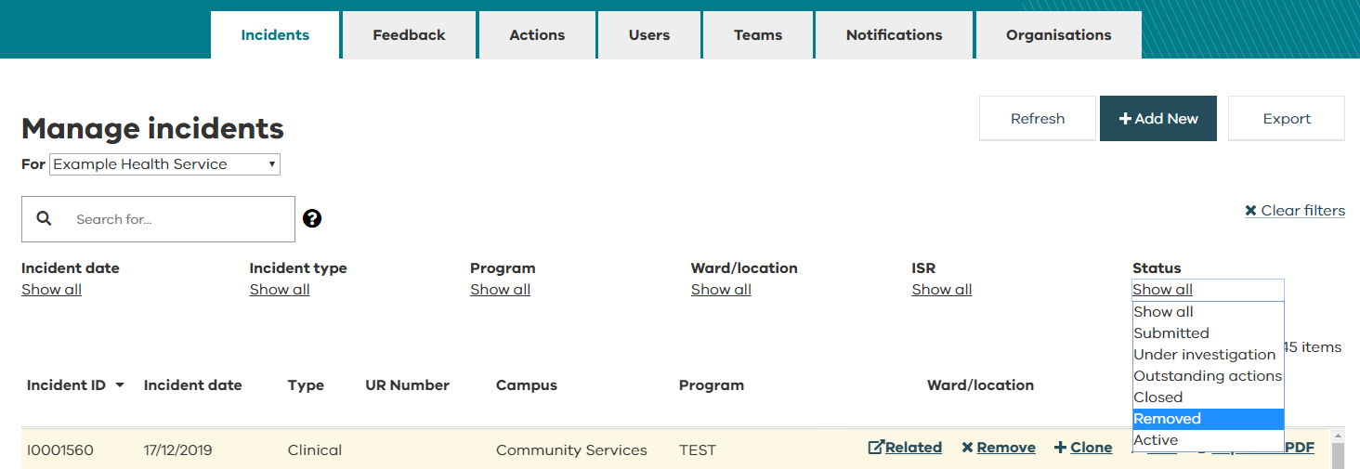
Removing and restoring incidents and feedback
Users with a role of ‘Helpdesk’ are able to remove and restore incidents and feedback records.
Removed records are not permanently deleted and can be restored.
Removed incidents and feedback records will be excluded from all reports and full data extracts.
These reports refresh overnight, so any changes made will not be reflected in reports until the next day.
All users can filter their incident and feedback dashboards by ‘Status’ to view removed records.
The ‘History’ tab will capture when a records has been removed/restored.

Slide 50
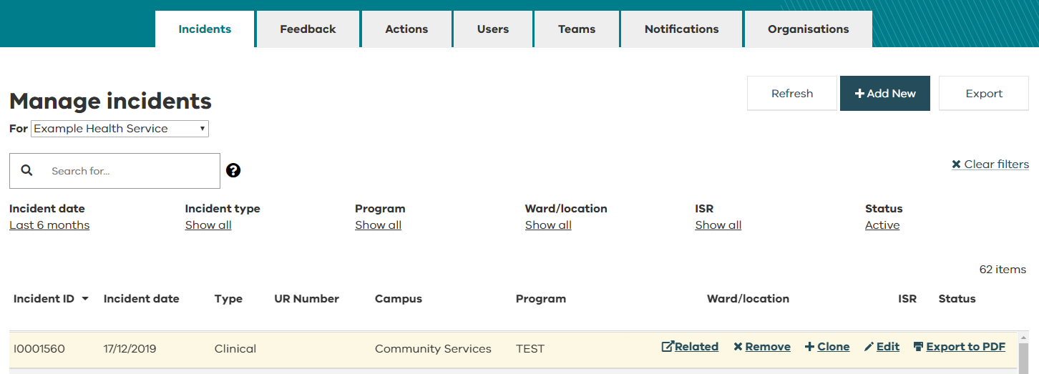
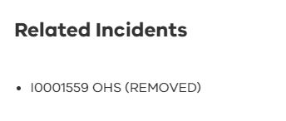
Removing incidents and feedback
To remove an incident, select Remove, from the dashboard. A new prompt will ask you to confirm you wish to remove the record.
All users are prevented from editing removed records.
To see the details of a removed record, select ‘Export to PDF’.
‘Related’ will show details of related incidents that have been removed.

Slide 51
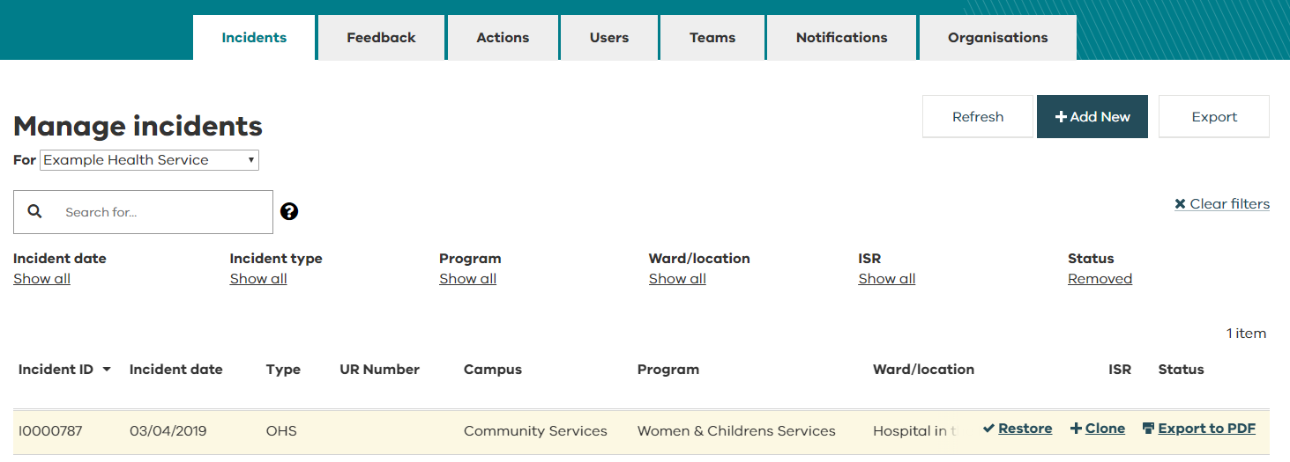
Restoring incidents and feedback
To restore a removed incident or feedback record, filter your dashboard to ‘Removed’.
Select Restore.
Restoring an incident/feedback record will make it available again to users for editing.
The record will also be restored in reports and full data extracts. NB: the data will refresh overnight so will be available in the extract and reports the following day.
The ‘History’ tab will capture when a records has been removed/restored.

Slide 52
System Reporting
System reporting

Slide 53
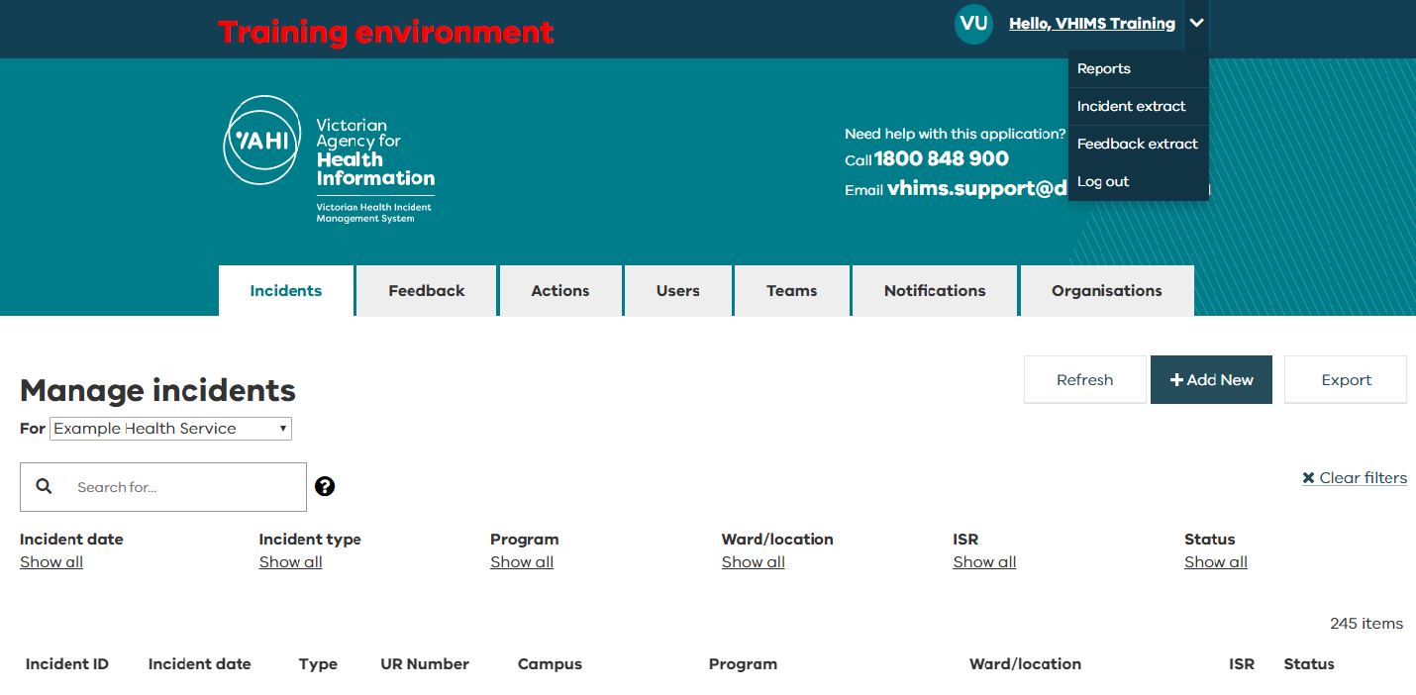
System Reporting
There are multiple ways to extract data for reporting purposes:
Reports
Pre-built reports for incidents, events, feedback and actions.
Available to all users.
Incident/Feedback extract
Full data extract of all your organisation’s incident and feedback data.
Only available for certain system roles
Dashboard export
Export feature available for Incidents, Feedback, and Actions.
Will export fields available on dashboard and select other fields.
Available to all users but will be limited to what they have permissions to see.
1
1
2
2
3
3

Slide 54
Logging off
Logging off

Slide 55
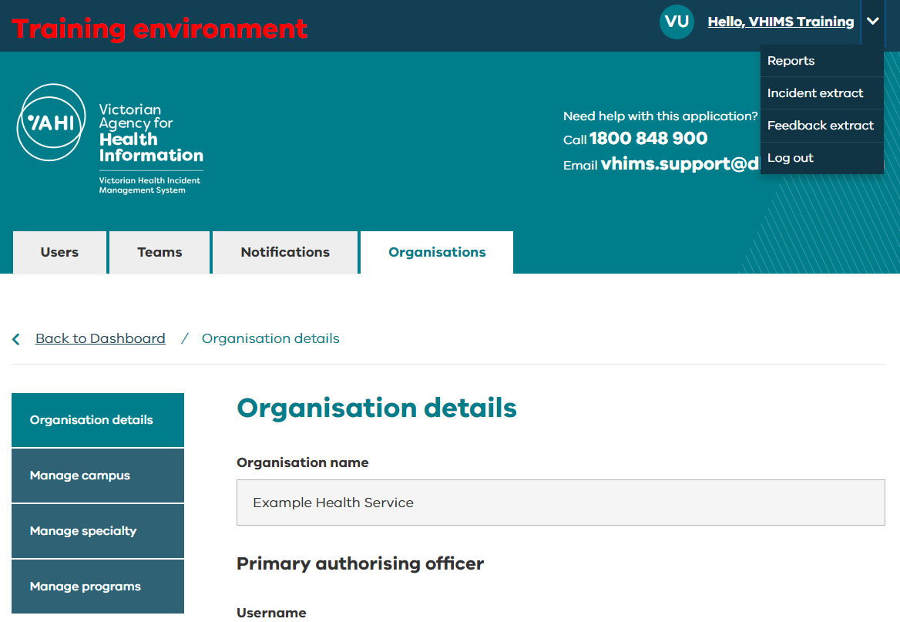
Logging off
Remember to log off the system.
If you don’t log off, the next time you attempt to log in, you may need to log out and back in to refresh the session.

Slide 56
For further information
For further information
Contact your local VHIMS CS administrator
Contact the VHIMS team: vhims2@vahi.vic.gov.au
Contact VHIMS Support using the details below:
1800 848 900
VHIMS CS education and training resources
vhims@support.vic.gov.au

