Slide 1
VHIMS Central Solution
Consumer Experience Outcomes and Safety | December 2024
Victorian Health Incident Management System
End User Training - Incidents

Slide 2
Table of contents
Select any section to go directly to that page.
1. System access | 3
1.1 Registration | 4
1.2 Logging in | 5
4. Entering a new incident | 20
4.1 Saving a draft | 23
4.2 Who | 24
4.3 Multi-person incidents | 26
4.4 On behalf of someone else | 28
4.5 When | 29
4.6 Where | 30
4.7 What happened | 31
4.8 Help us improve | 35
4.9 Submit your incident | 36
5. Managing Incidents | 37
5.1 Edit an existing incident | 38
5.2 Why and how | 40
5.3 Actions | 42
5.4 Actions definitions | 43
5.5 Adding an action | 44
5.6 Recording your own actions | 46
5.7 Sign-off | 47
5.8 Upload documents | 50
5.9 History | 51
7. Reports | 57
7.1 Accessing reports | 58
7.2 Filtering data | 60
7.3 Related to care by this organisation only | 61
7.3 Enlarging charts and exporting data | 62
7.4 Printing reports and adding a visual table | 63
2. System roles and permissions | 6
3. Incident dashboard | 9
3.1 Defaults | 11
3.2 Applying a filter | 12
3.3 Searching for incidents | 13
3.4 Related incidents | 14
3.5 Edit an existing incident | 15
3.6 Export to PDF | 16
3.7 Read/unread records | 17
3.8 Resume draft | 18
3.9 Incident data export | 19
8. Cloning incidents | 64
9. Profile delegation | 68
6. Actions dashboard | 52
6.1 Edit an existing action | 55
10. Logging off | 71
11. For further information | 73

Slide 3
System access
System access

Slide 4
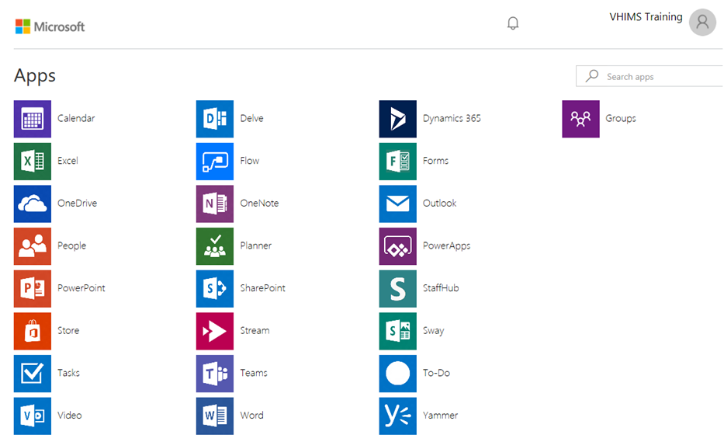
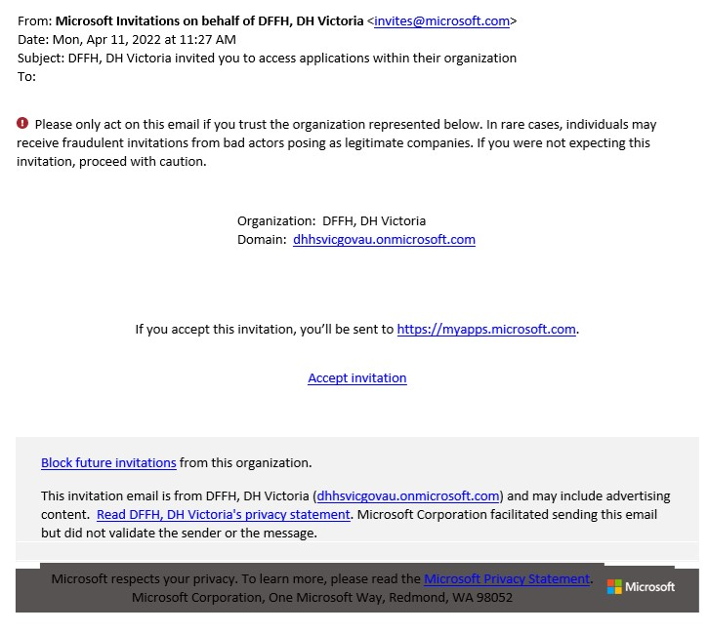
System access - registration
VHIMS CS is hosted in a cloud-based environment called Microsoft Azure.
Once VHIMS Support have added a new user to the system, the staff member will receive an individual once-off email (example below) to complete their account set up.
New staff will need to click ‘Accept Invitation’ to activate their Azure account.
Follow the instructions (if provided).
A dashboard with applications may appear (example above).
Close this page when you land on the dashboard.
Proceed to your VHIMS CS site and login to access the system.

Slide 5
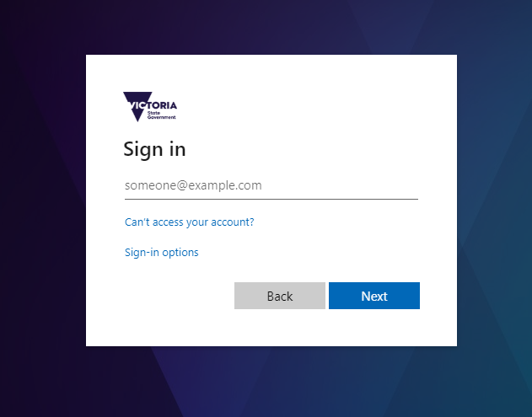
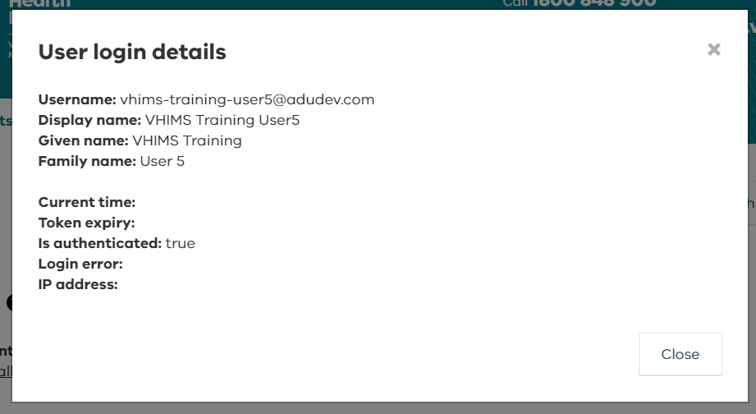

System access – logging in
The link to your live VHIMS CS system will be available through your organisation.
Your login information for the live VHIMS CS system will be:
      Username: your work email
      Password*: your Microsoft Azure password
      (usually the same as your work email password)
*Depending on how your organisation is set up, you may also be prompted to change or create a password when you log in.
If you get an error when attempting to log in, it may because you are using a shared computer, and another user has not logged off.
To see who is logged in, click the round button in the top right corner:

Slide 6
Roles and permissions
VHIMS CS system roles and permissions

Slide 7
VHIMS CS system roles and permissions
A user can only be assigned one VHIMS CS system role.
The system role that is assigned to a user will determine what incidents they can see via their dashboards, and what sections of the VHIMS CS system they have permission to access.
All system roles (apart from the organisation admin role) have access to the Incidents tab and the Actions tab.
Most users are assigned the role of Reporter, Staff or Manager.
Speak to your local VHIMS CS administrator if you think you need a different system role.
You can find more information in the Roles and Permissions resource.

Slide 8
Overview of VHIMS CS system roles and permissions
 | Permissions | Reporter | Staff | Manager | OHS Manager | CLO | Risk Manager | Executive | Helpdesk | Organisation Admin
INCIDENTS | Create Incidents |  |  |  |  |  |  |  |  | 
 | View/edit OHS incidents created by another user on my behalf |  |  |  |  |  |  |  |  | 
 | View/edit incidents containing actions that are assigned to me |  |  |  |  |  |  |  |  | 
 | View/edit all incidents as routed by notification rules |  |  |  |  |  |  |  |  | 
 | View all ‘clinical’ incidents within my organisation on my incident dashboard |  |  |  |  |  |  |  |  | 
 | View all ‘OHS’ incidents and ‘Hazards’ within my organisation on my incident dashboard |  |  |  |  |  |  |  |  | 
 | View ALL incidents within my organisation on my incident dashboard |  |  |  |  |  |  |  |  | 
 | Be a line manager |  |  |  |  |  |  |  |  | 
 | Manage incidents (edit Why & How, close / re-open incidents) |  |  |  |  |  |  |  |  | 
FEEDBACK | Create Feedback |  |  |  |  |  |  |  |  | 
 | Manage feedback (close / re-open feedback) |  |  |  |  |  |  |  |  | 
 | Remove/ Restore incident and feedback records |  |  |  |  |  |  |  |  | 
 | View ALL feedback records within my organisation on my feedback dashboard |  |  |  |  |  |  |  |  | 
REPORTS | View Reports |  |  |  |  |  |  |  |  | 
 | Access Incident extract (full data extract for Incidents) |  |  |  |  |  |  |  |  | 
 | Access Feedback extract (full data extract for feedback) |  |  |  |  |  |  |  |  | 
OTHER | Access Actions |  |  |  |  |  |  |  |  | 
 | View incidents as Read/Unread on Incident, Feedback, and Actions dashboards |  |  |  |  |  |  |  |  | 
 | Access My Profile to delegate my permissions |  |  |  |  |  |  |  |  | 
 | View/edit all incidents that another user has access to, if they have delegated to me |  |  |  |  |  |  |  |  | 
 | Access the Administration module (Users, Teams, Notifications, and Organisation) |  |  |  |  |  |  |  |  | 

Slide 9
Incident dashboard
Incident dashboard

Slide 10
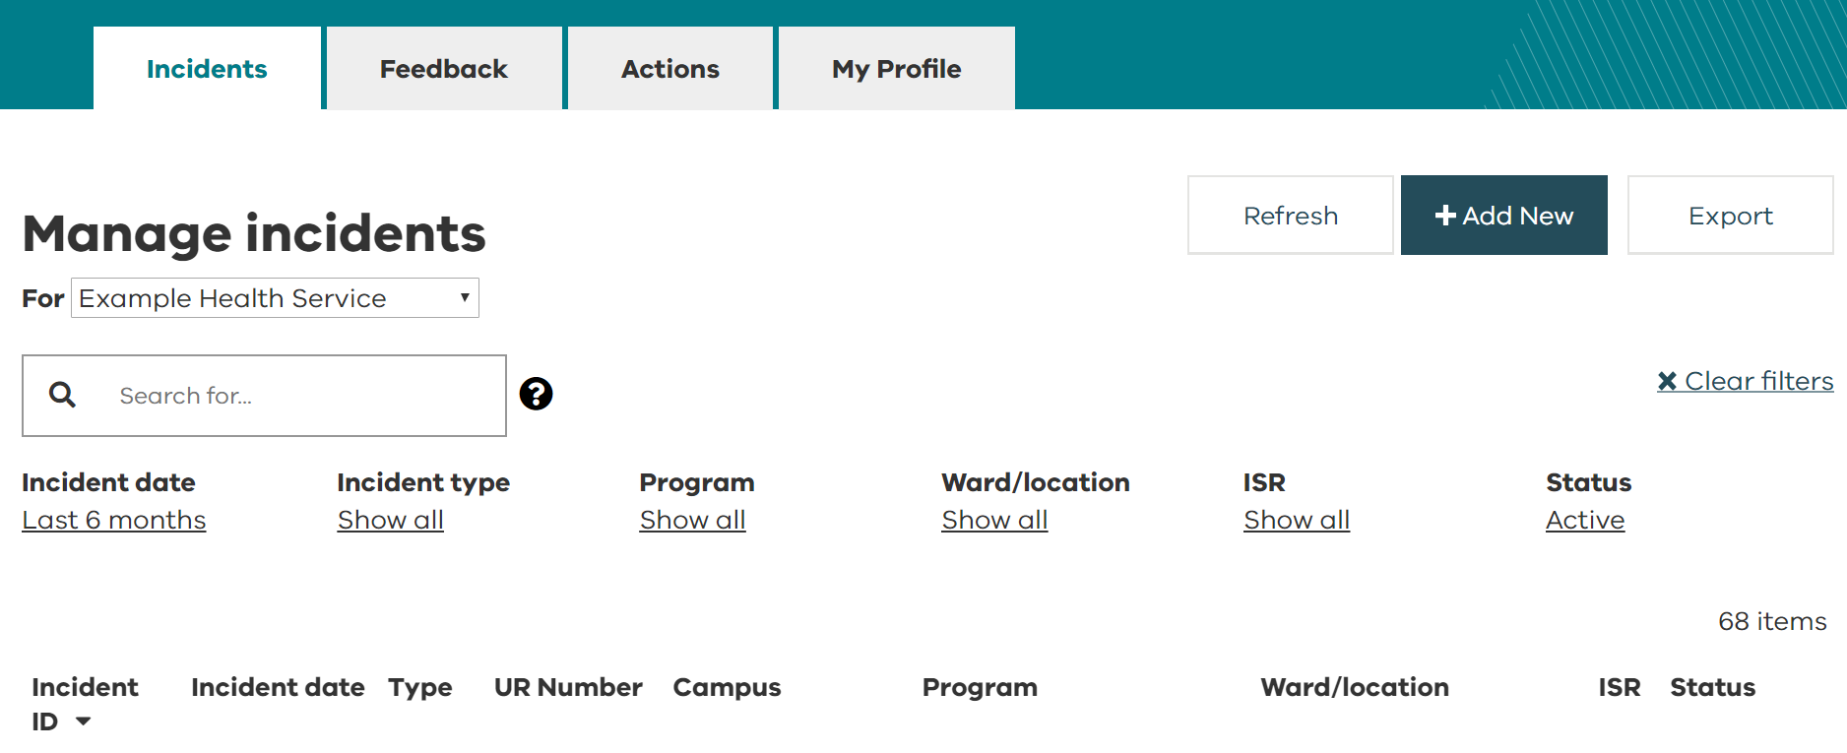
Incident dashboard
This is the screen that will open when you log in to VHIMS CS.
The tabs that you will have access to are related to your assigned system role.
Most users will only see Incidents and Actions.
The incident dashboard will display the incidents you have entered, and any incidents that you have access to due to your role (refer to VHIMS CS system roles and permissions).

Slide 11
Incident dashboard – defaults
The dashboard will default to display only ‘Active’ incidents occurring in the last six months.
‘Active’ incidents have a status of submitted, under investigation, or outstanding actions.
Incident status | Definition
Submitted | A user has submitted an incident.
Under investigation | A manager has opened the incident to review it and investigate.
Outstanding actions | One or more actions are open.
Closed | The incident has been signed off. Incidents that have been signed off even if there are still outstanding actions will be marked as ‘closed’.
Removed | The record is no longer available to users for editing and has been removed from all reports. Refer to your system administrator with any questions.

Slide 12
Incident dashboard – applying a filter
You can search for incidents by applying filters to the dashboard headings.
Click to show the dropdown options.
Choose to remove any filters and restore default settings.
Tip! | Incident date defaults to ‘last six months’ and Status defaults to ‘Active’. If you can’t find an incident on your dashboard, you may need to adjust these filters.

Slide 13

Incident dashboard – searching for incidents
The free text search allows you to search all columns displayed on the dashboard, as well as:
summary
name of reporter
name of the affected person
event types.
As you enter information into the search bar, only matching or partially matching incidents will show on the dashboard.
Click on the symbol for help on searching.

Slide 14
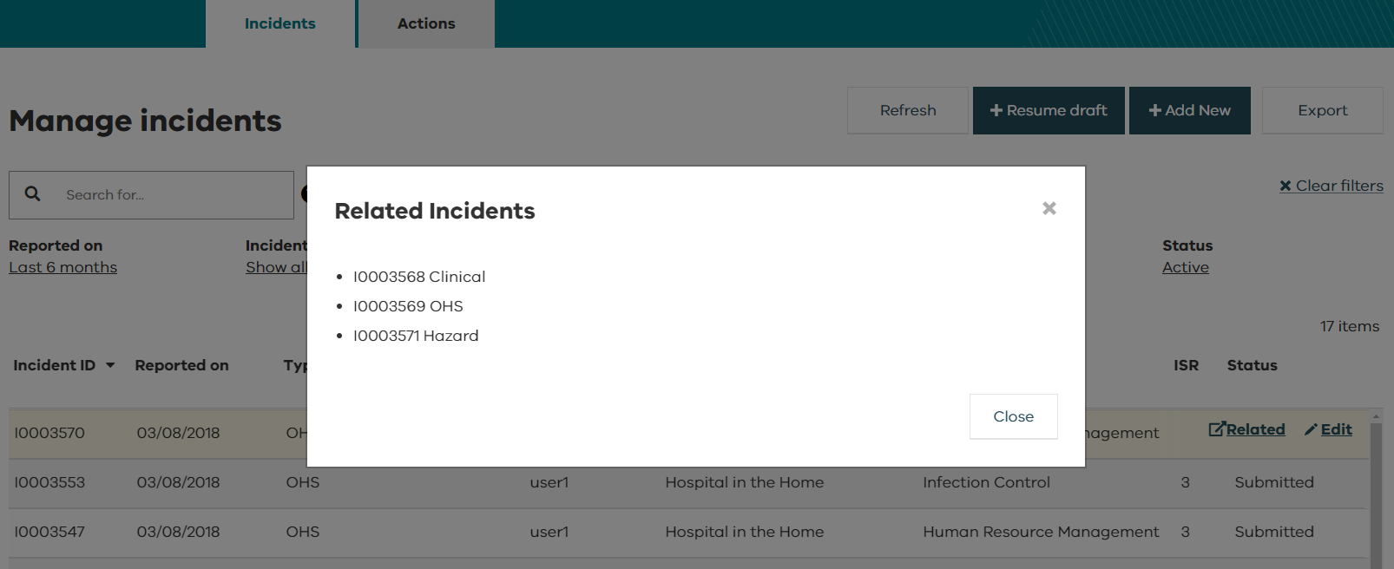
Incident dashboard – related incidents
To check for any incidents and/or hazards that were entered for the same event, hover over the incident (refer to entering multi-person incidents for more information).
If Related (beside Edit) appears, you can click it to see the details of any associated incidents.

Slide 15
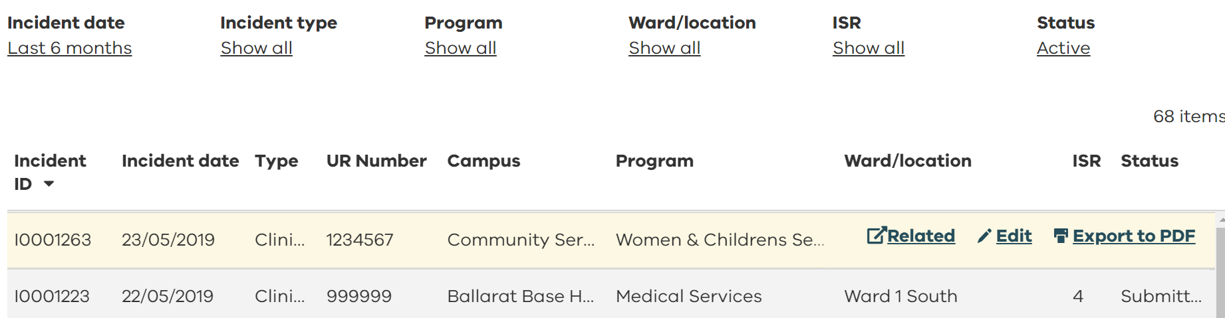
Incident dashboard – edit an existing incident
To edit an incident, double click or hover over the record you wish to amend and click on Edit (refer to edit an existing incident )
Incidents with a status of ‘Removed’ cannot be edited.

Slide 16
Incident dashboard – export to PDF
If you Export to PDF, you will get a PDF incident report with all information entered for that incident.
This feature is not available for ‘Draft’ incidents but ‘Removed’ incidents can be exported to PDF.

Slide 17

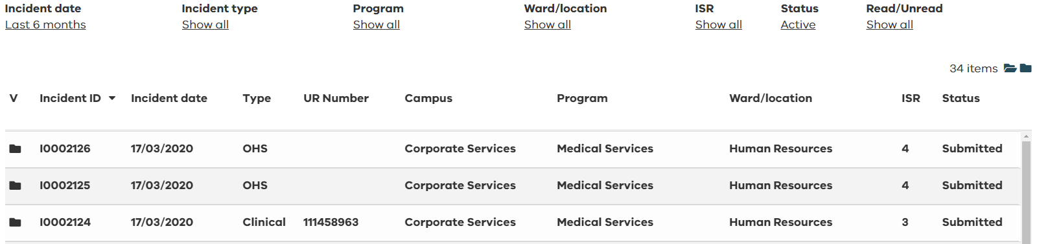
Incident dashboard – read/unread records
Some users have the ability to distinguish between read/unread records on their incident, feedback, and actions dashboard (refer to VHIMS CS system roles and permissions).
You can filter your dashboard by read/unread.
To mark individual records as read/unread, click on the folder symbol in the (viewed column).
To mark all records as read, select .
To mark all records as unread, select .

Slide 18
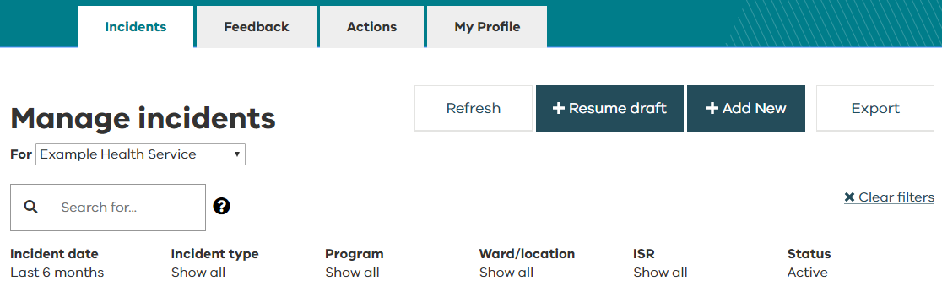
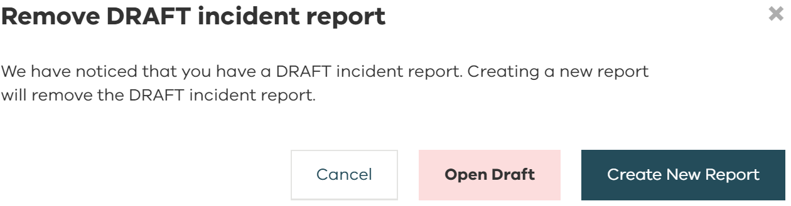
Incident dashboard – resume draft
If you have saved a draft incident, when you return to the incidents dashboard you will see the +Resume draft button.
Select this to resume working on the incident.
If you click +Add New when there is a draft stored, an alert will confirm if you want to remove your draft.
Tip! | If you chose to ‘Create New Report’ the stored draft will be removed.

Slide 19
Incident dashboard – incident data export
You can export incident data from your dashboard.
The export feature is often used for internal reporting purposes.
Adjust all dashboard filters to ‘Show all’ if you want an export of every incident available to you, but this doesn’t mean you are able to export all incident data for your organisation.
The incident data you can export depends on your system role and permissions (refer to VHIMS CS system roles and permissions
The export will include these fields:
  Incident ID
  Incident Type
  Other Related Incidents
  Incident Count
  UR Number
  Surname
  Incident Date
  Notification Date
  Closed Date
  Organisation
  Campus
  Program
  Ward / Location
  Specialty / Unit
  Event Types
  ISR
  Brief Summary
  Incident Status
  Sentinel Event Type
  Health Service Standards
  Was open disclosure conducted?
  Review type
  Is VMIA notifiable?

Slide 20
Entering a new incident
Entering a new incident

Slide 21
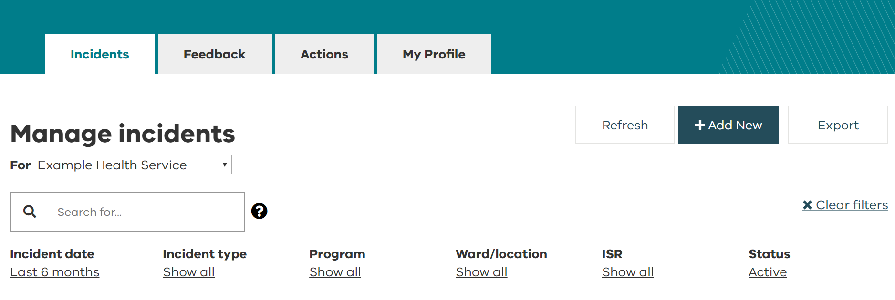
Entering a new incident
From the Incidents dashboard, choose + Add New.

Slide 22
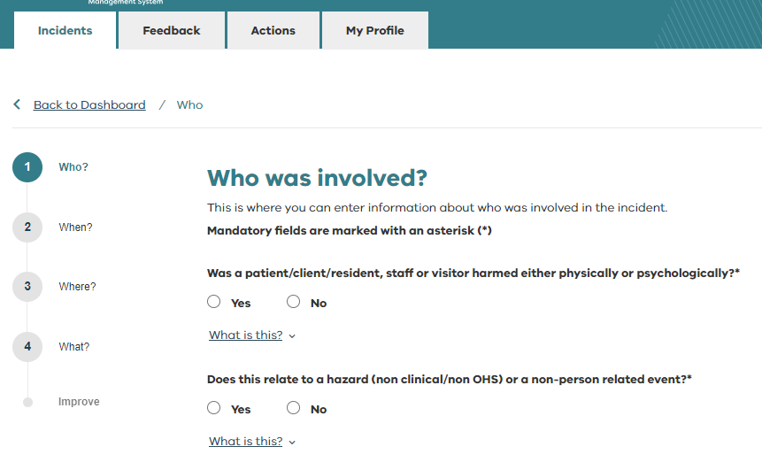
Entering a new incident
Answer questions for:
  Who?
  When?
  Where?
  What?
  Improve
The wizard along the side will show you your progress.
Mandatory fields are marked with an asterisk (*).
Choose for tool tips and more information about questions throughout the system.

Slide 23
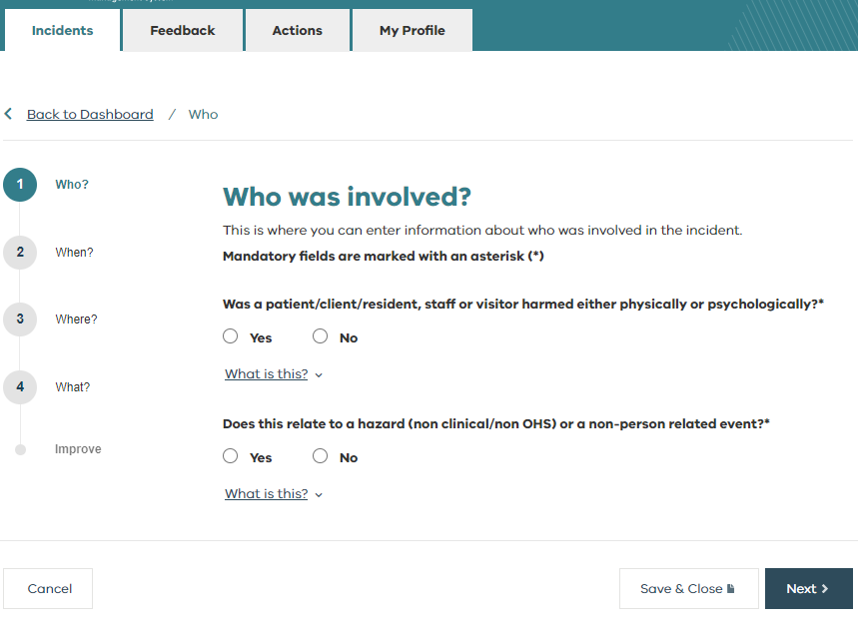

Entering a new incident – saving a draft
The system can store one incident as a draft at a time.
To save a draft at any stage while entering an incident, select ooooooo located on the bottom right side of the screen.
Whenever you select ‘Save & Close’ instead of ‘Next’, your incident will be saved as a draft, and your screen will return to the Incidents dashboard.
If you accidentally close your browser window, your incident will automatically be saved as a draft up until the last page where you clicked ‘Next’.
Select +Resume draft to pick up where you left off (refer to resume draft).

Slide 24
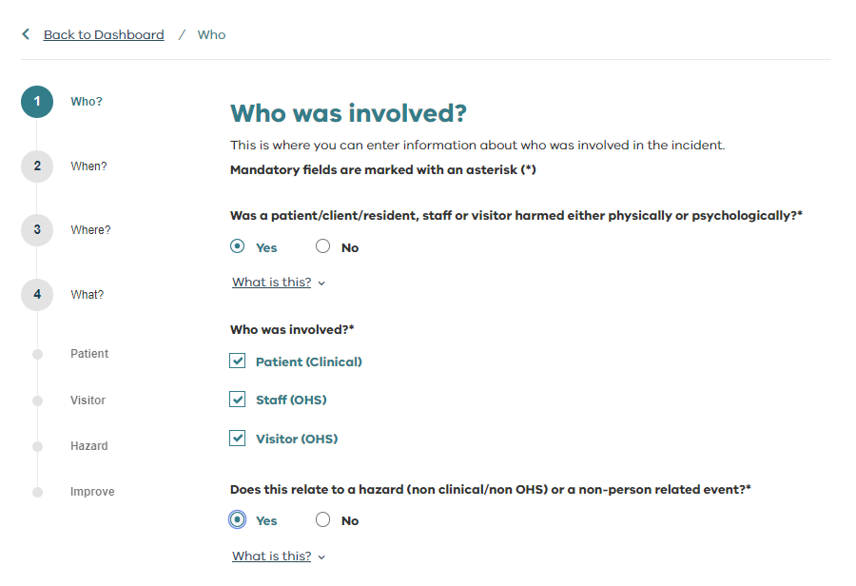
Entering a new incident – who?
Enter information about who was involved in the incident.
These questions will determine what type of incident(s) or near misses the system needs to create, including:
Patient (Clinical)
Staff (OHS)
Visitor (OHS)

Slide 25
Entering a new incident – who?
Selecting patient will create a
clinical incident
Selecting staff or visitor will create an OHS incident
If you add multiple staff, or multiple patients, multiple incidents will be created.
Answering ‘Yes’ will create a
hazard
(non-clinical/non-OHS event)

Slide 26
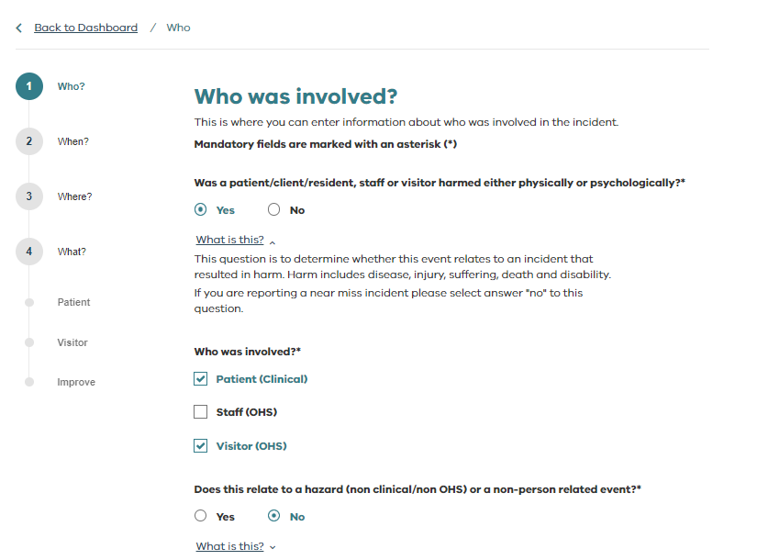
Entering a new incident – multi-person incidents
Multi-person incidents
Where multiple people were affected by the same event, click the appropriate check boxes under ‘Who was involved?’.
Details for who, when, and where will only need to be entered once.
The wizard on the left under ‘What?’ will change depending on who was involved.

Slide 27
Entering a new incident – multi-person incidents
Multi-person incidents
For example, from the screenshot on the right, patient, visitor, staff and hazard are selected. In this case, three separate incidents will be created for the one event.
Each incident will have its own incident ID.
This will allow the incidents to be directed to the appropriate teams and managers and ensures that confidentiality is protected.
These will appear as Related incidents on the Incidents dashboard (refer to related incidents).

Slide 28
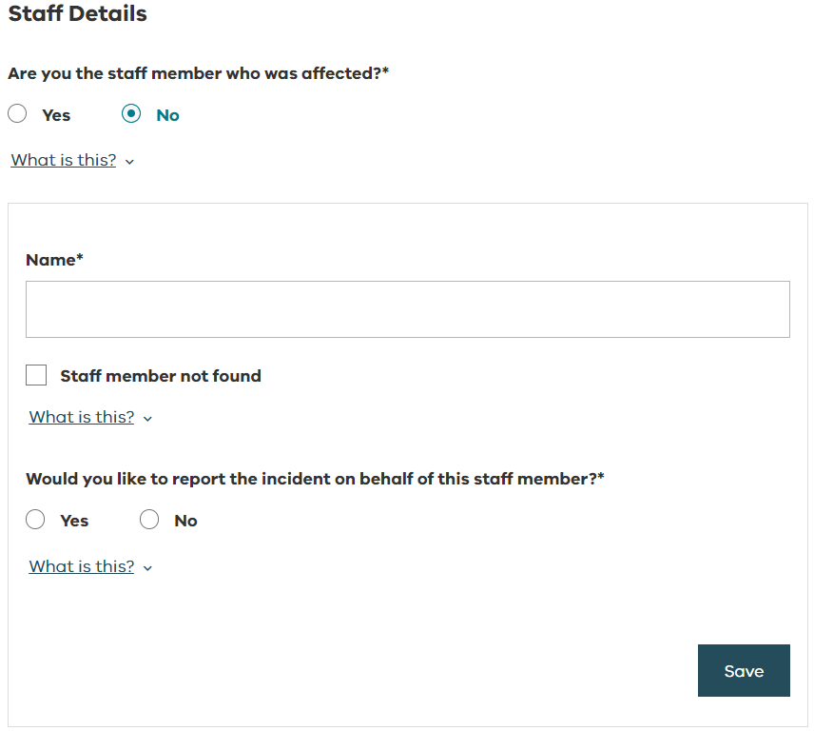
Entering a new incident – on behalf of someone else
Entering an incident on behalf of someone else
If you are the staff member affected, your details will automatically appear.
Multiple staff members can be added.
You can also report an incident on behalf of another staff member. They will receive and email notification and will now have the ability to edit it. To protect their privacy, you will not be notified of the outcome.
If you think a colleague may have been impacted, you can answer ‘No’ to this question. The system will send them an email encouraging them to report how they have been impacted by this event.

Slide 29
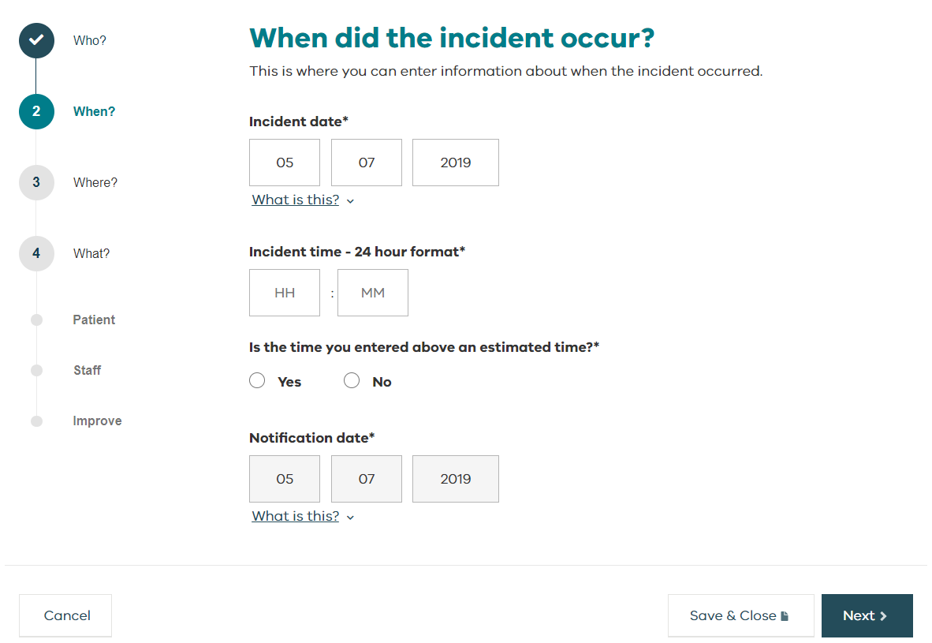
Entering a new incident – when?
Incident date is the date on which the incident occurred.
Incident date defaults to today’s date.
Change the default date if the incident occurred at an earlier date
Use 24-hour time format when entering the time of the incident.
Notification date is the date the incident was reported and will always default to today’s date. It cannot be changed.
Note: Take care that incorrect dates such as Dates of Birth are not entered in the incident date field

Slide 30
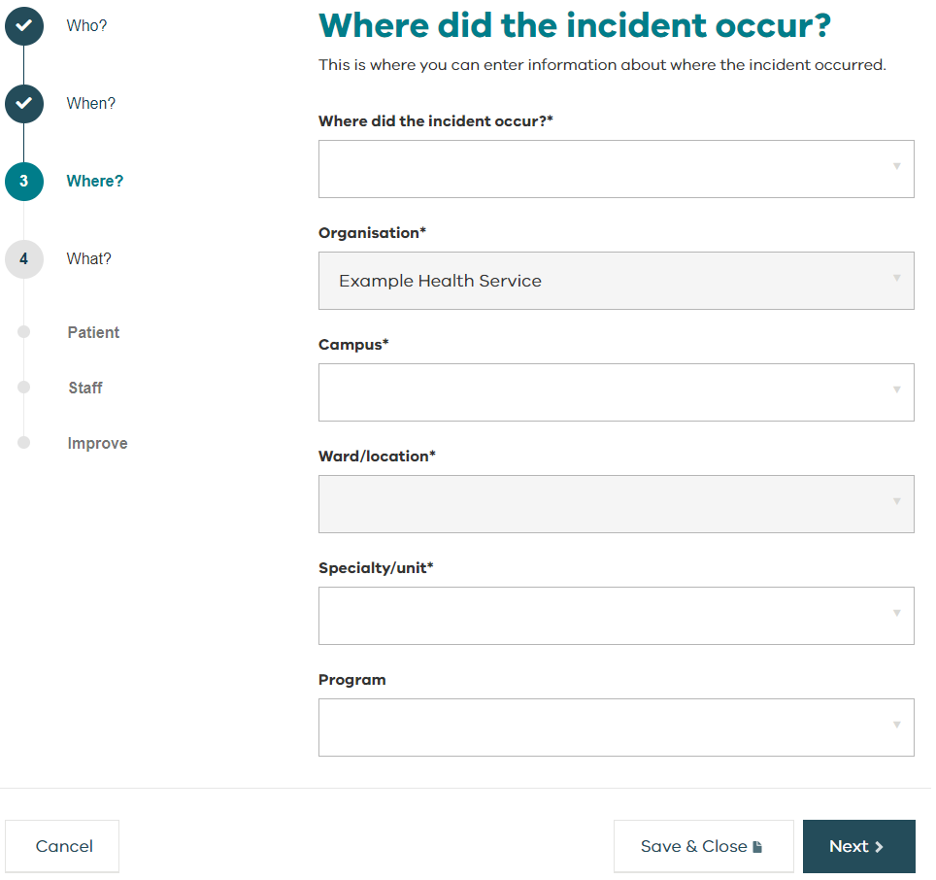
Entering a new incident – where?
Select the most appropriate locations.
These dropdown options have been configured by your organisation.

Slide 31
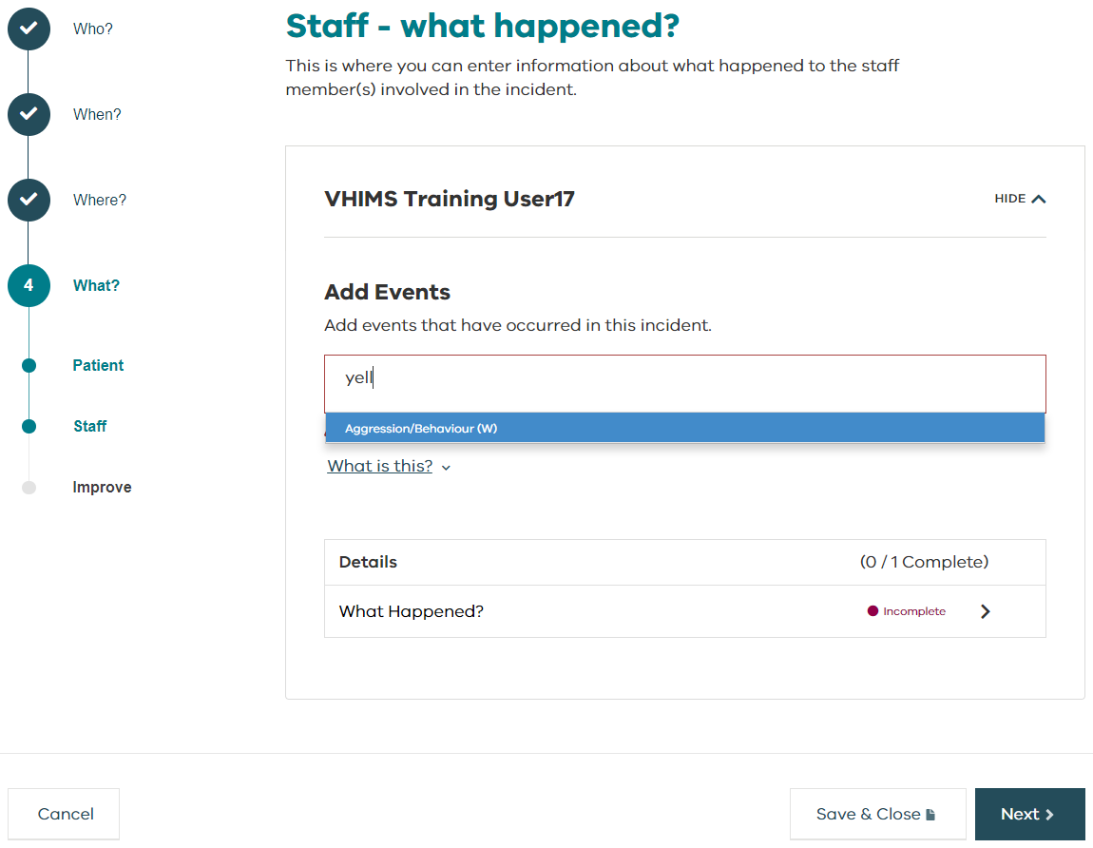
Entering a new incident – what happened?
The section needs to be completed for everyone who was involved.
Click into the box under Add Events.
Select the most appropriate incident type by:
  Scrolling through the dropdown list of event types or
  Type a keyword* into the box to reduce the number of options (then click to select).
Repeat to add as many event types as required.
* Event types are tagged with keywords so when you start typing only related incident types will appear.

Slide 32
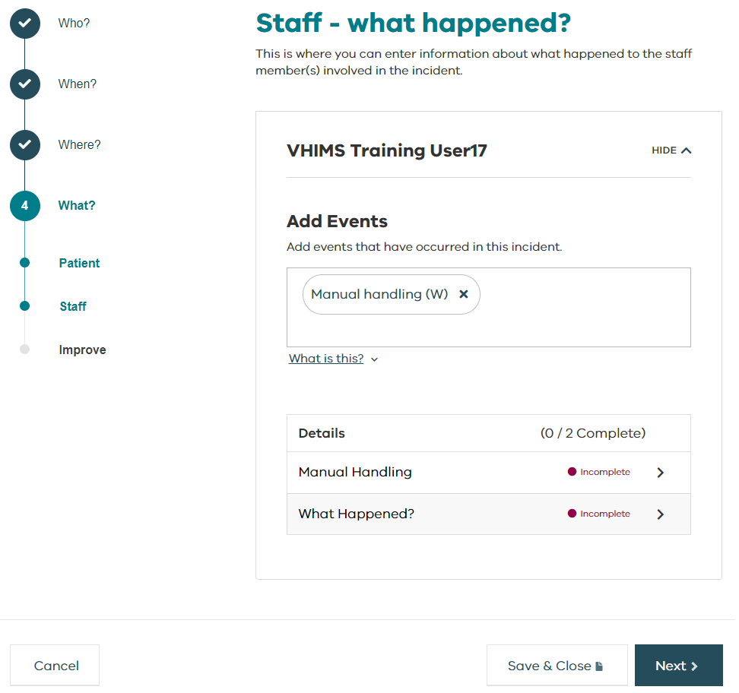
Entering a new incident – what happened?
Depending on which event types are selected, there may be additional questions to answer.
These will appear under Details when event types are added.
Click on the arrow to answer the questions.
Repeat until all sections are complete.

Slide 33
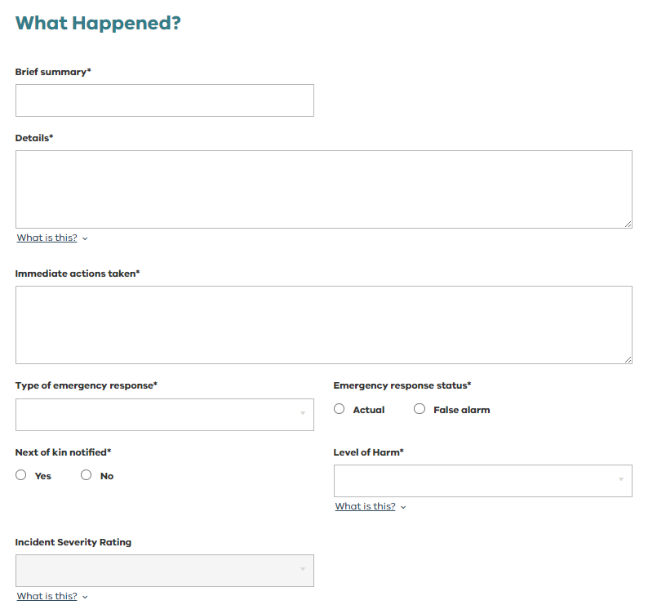
Entering a new incident – what happened?
What Happened questions must be answered for every incident.
The Incident Severity Rating (ISR) is a derived value between 1-4 that measures the severity of impact caused to the person affected following an incident.
It is calculated automatically when you answer the relevant questions.
There are different questions and ISR algorithms for Patient (Clinical) incidents, Staff (OHS) incidents, Visitor (OHS) incidents, and hazards.

Slide 34
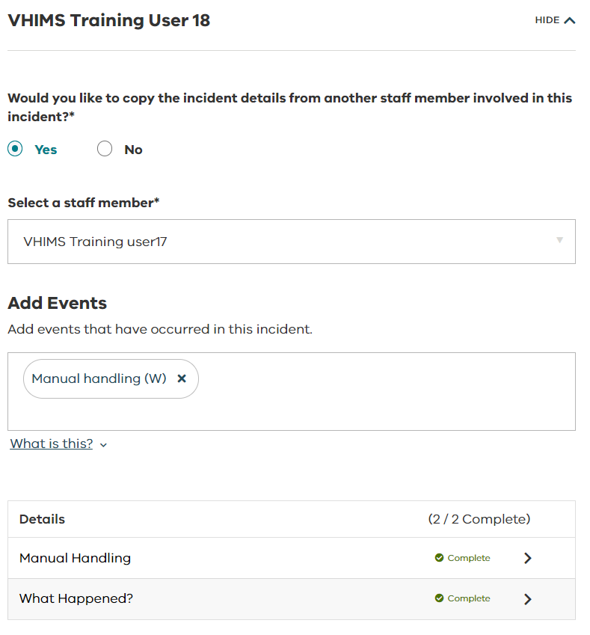
Entering a new incident – what happened?
Multi-person incidents
If multiple staff or patients have been involved in an incident, you can copy the incident details. You don’t have to enter them twice.
Details can only be copied from patient-patient, staff-staff or visitor-visitor.
Even though the sections are complete, you may want to edit the details as the individuals may have been affected differently.
Separate incident IDs will be created for each affected person.

Slide 35
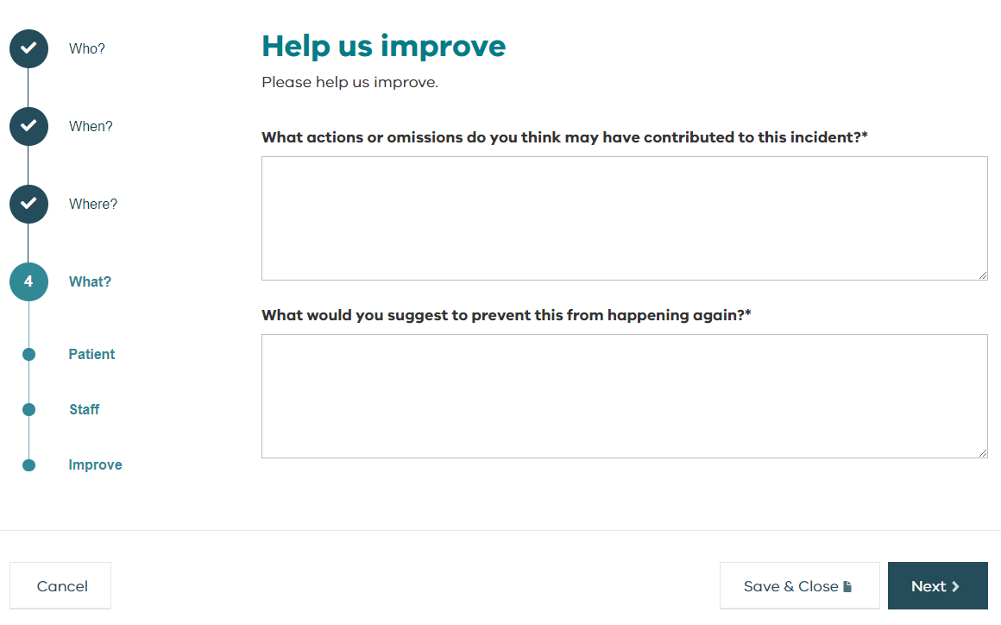
Entering a new incident – help us improve
This section provides an opportunity for front-line staff to provide feedback on how their organisation can improve/learn from the incident being reported.
Enter your ideas to contribute to a safer workplace and help your service identify improvement opportunities.
This section is mandatory.
If you have nothing to say, type N/A.

Slide 36
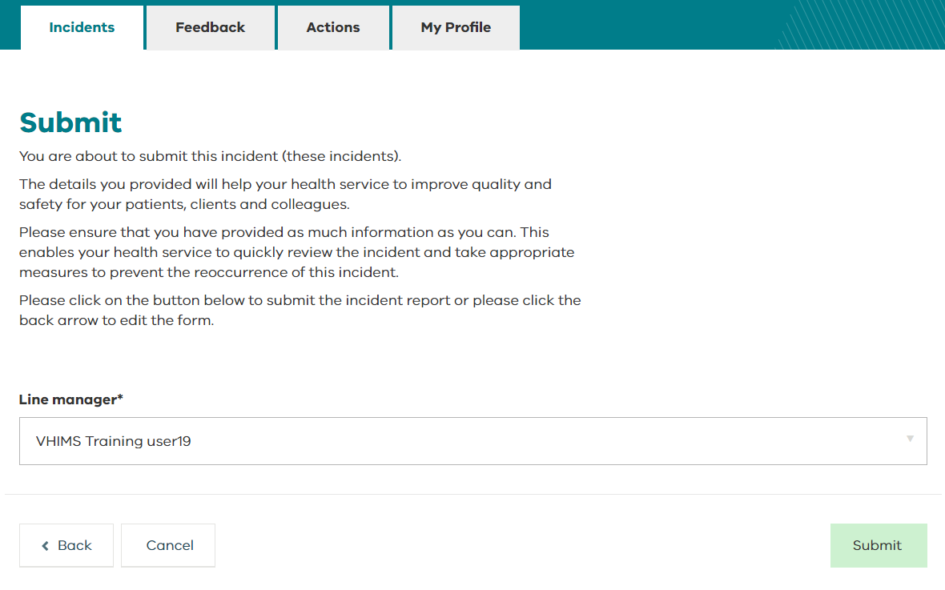
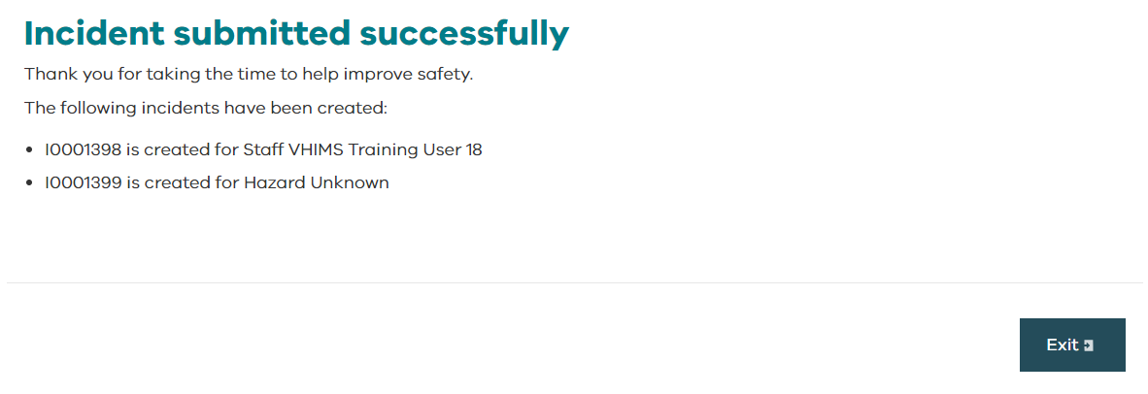
Entering a new incident – submit
If you report to multiple managers, before you submit an incident you will be able to select the appropriate line manager to be notified.
Your manager(s) will appear at the top of the list, but you can select from all managers in the system.
To submit the incident(s), click on the green Submit button.
To edit any of the previous screens, click on the Back button.
You will see an Incident submitted successfully message confirming your incident has been submitted, including a list of all the incident number(s) you have created.
Click the Exit button to return to the dashboard.

Slide 37
Managing incidents
Managing incidents

Slide 38
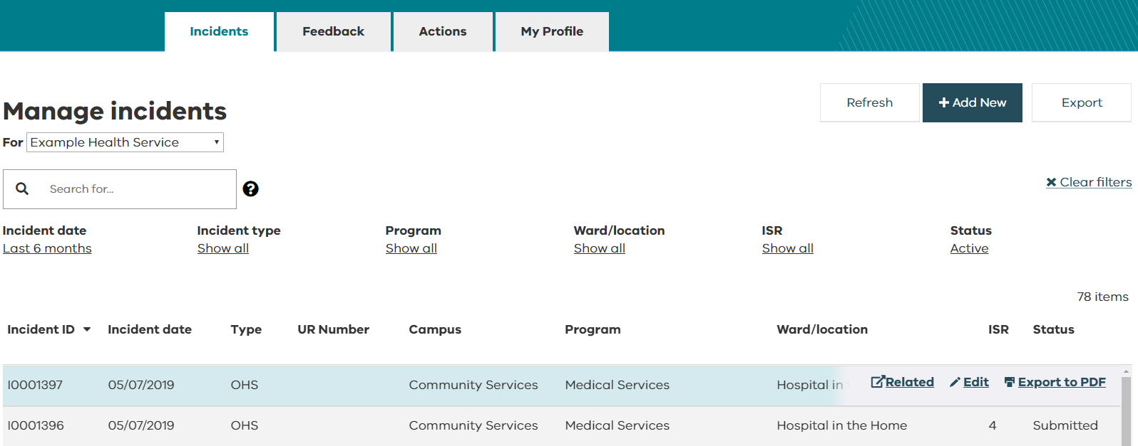
Managing incidents – edit an existing incident
To open an incident, you can double click it or select Edit from your incidents dashboard.

Slide 39
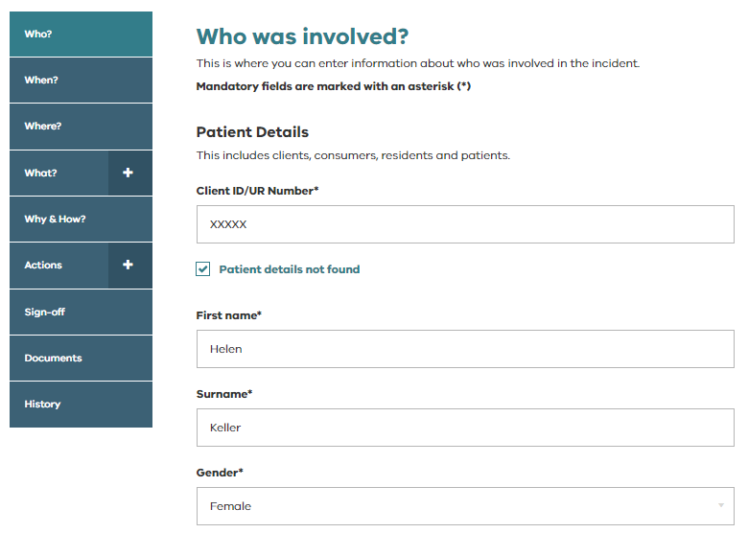
Managing incidents – edit an existing incident
When you are editing or viewing a submitted incident, the sidebar will look different. It displays the following additional components:
  Why & How?
  WorkSafe (for staff incidents)
  Actions
  Sign-off
  Documents
  History

Slide 40
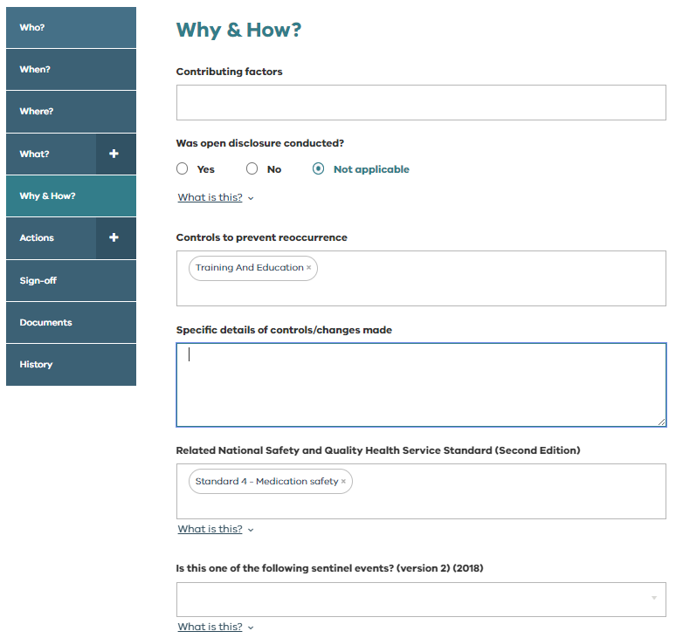

Managing incidents – why & how?
*For Managers
The Why & How sections can only be edited by managers.
If you are not authorised to edit/complete this section, you will see this message:
This section captures additional information and details related to the investigation of the incident.
The fields in this section will be different depending on the type on incident.
When an incident is closed, the staff member reporting the incident will receive an email and be able to view this information.

Slide 41


Managing incidents – why & how?
*For Managers
The Why & How sections contains some important question related to VHIMS MDS reporting
Is this a Clinical Incident? - only reported for Clinical incidents. This field indicates that following review, the incident is found to have been an event or circumstance that resulted or could have resulted in unintended or unnecessary harm to a person receiving clinical care or client services.
Did treatment and care at this health service contribute to unexpected or unintended harm to the patient? (APSE Flag) – This field is only completed where Yes is reported for Is this a clinical incident?
For further information Clinical incident and APSE flags - Guidance for health services implementing the VHIMS MDS version 2.

Slide 42
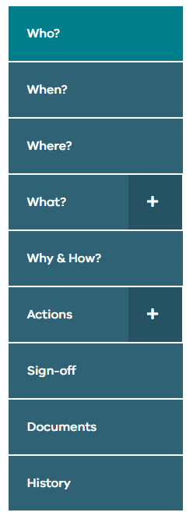
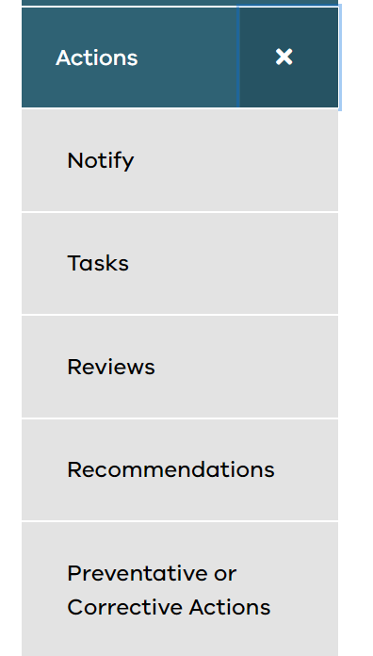
Managing incidents – actions
Once an incident has been submitted, you can edit the incident and add an action.
Select Actions.
There are different types of actions available that can be assigned to VHIMS CS users within your organisation.

Slide 43
Managing incidents – action definitions
Action | Definition
Notify | Use the notify action to share this incident with another staff member. They will receive an email and be able to access this incident.
Tasks | Use the task action to ask another staff member for their advice/input or assistance with the incident e.g. please add this incident to the agenda for our next OHS committee. The staff member will receive an email, have access to this incident and this task will appear on their actions dashboard until it is complete.
Reviews | Use the review action to detail and allocate an incident investigation to a staff member. The staff member will receive an email, have access to this incident and this review will appear on their actions dashboard until it is complete.
Recommendations | Use the recommendation action to detail and allocate recommendations that result for a review of this incident. The staff member responsible for each recommendation will receive an email, have access to this incident and this recommendation will appear on their actions dashboard until it is complete. They will also be sent reminder emails about this recommendation.
Preventative or Corrective Actions (OHS incidents only) | Use the preventative or corrective actions section to record contributing factors and detail and allocate preventative/corrective actions. The staff member responsible for each preventative/corrective action will receive an email, have access to this incident, and this preventative/corrective action will appear on their actions dashboard until it is complete.

Slide 44
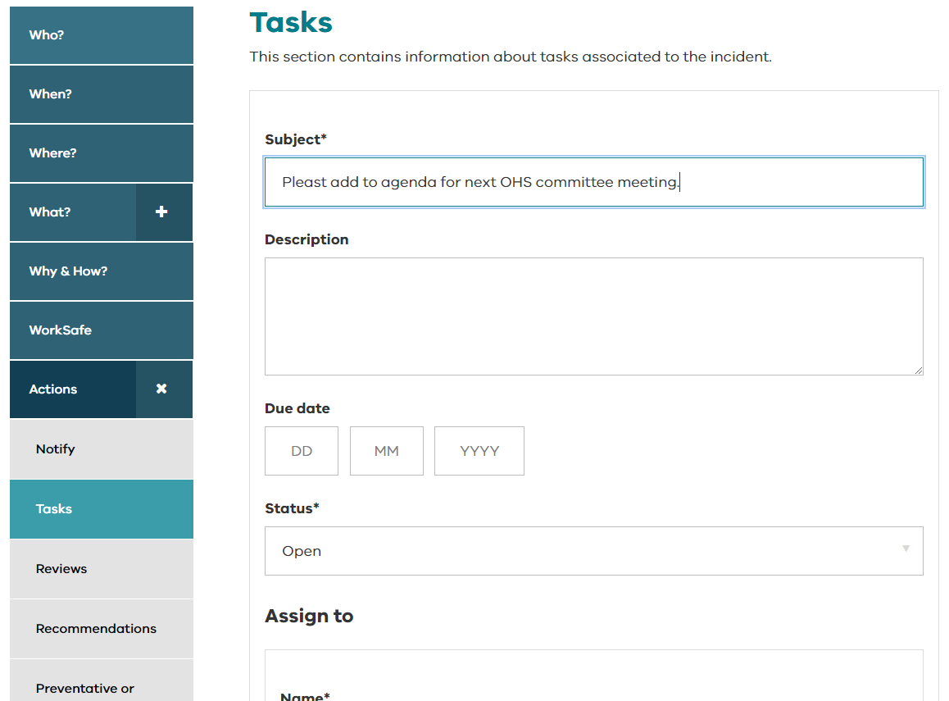
Managing incidents – adding an action
The process is similar for entering different types of actions (notify, tasks, reviews, recommendations, or preventative/corrective actions).
This example is for adding a new task.
  select Add New Task.
  complete the details.
  add a due date (optional)
  assign to a staff member(s)
  save
Tip! | When you assign someone an action, they will receive an email notification, and the task will now appear on their actions dashboard.

Slide 45
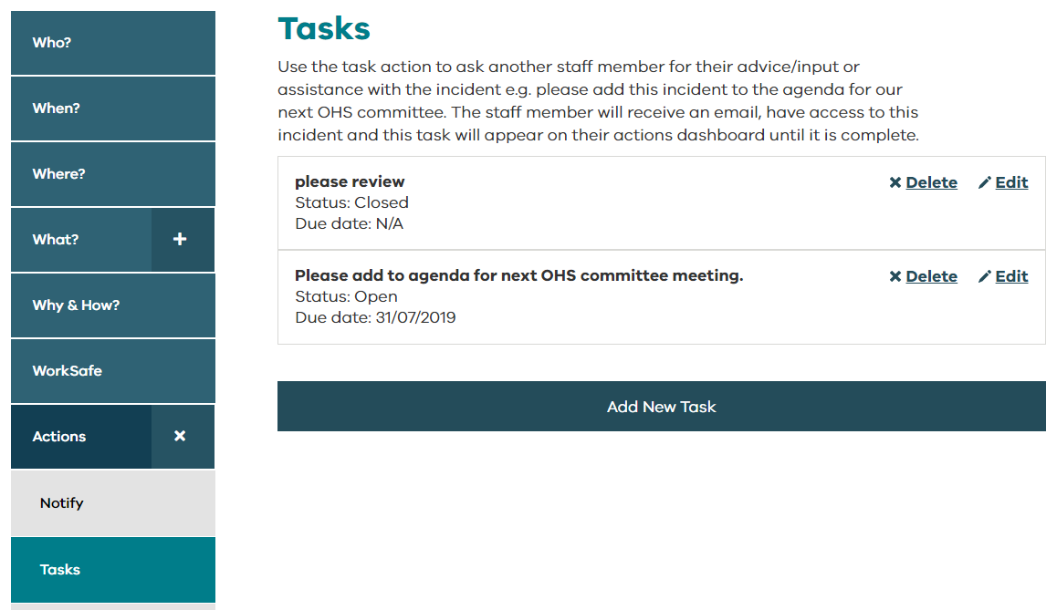
Managing incidents – adding an action
You can add as many actions as required.
This is what a saved task will look like:

Slide 46
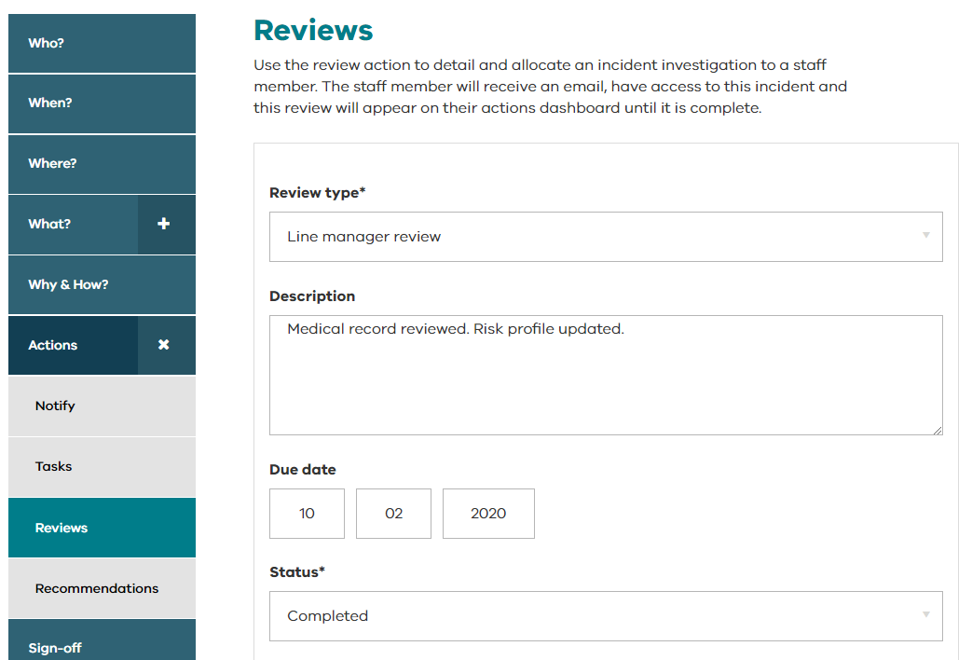
Managing incidents – recording an action for yourself
If you want to record an action that you took, simply assign it to yourself and mark it as closed when complete.

Slide 47
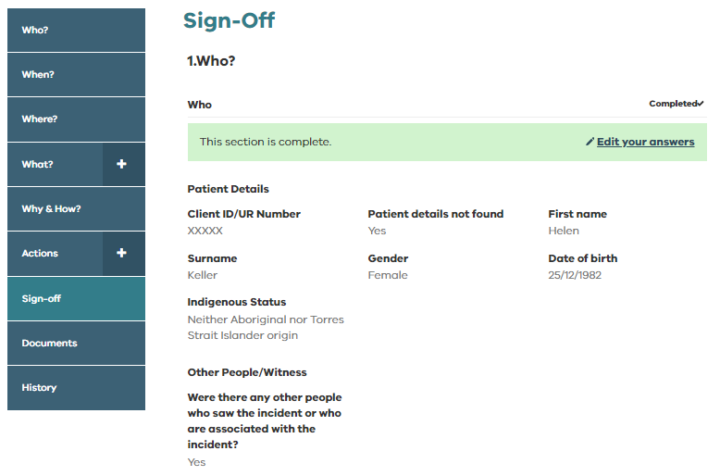
Managing incidents – sign-off
*For Managers
This is where you sign-off an incident and mark it as closed.
You can see all the information relating to the incident on one screen.

Slide 48
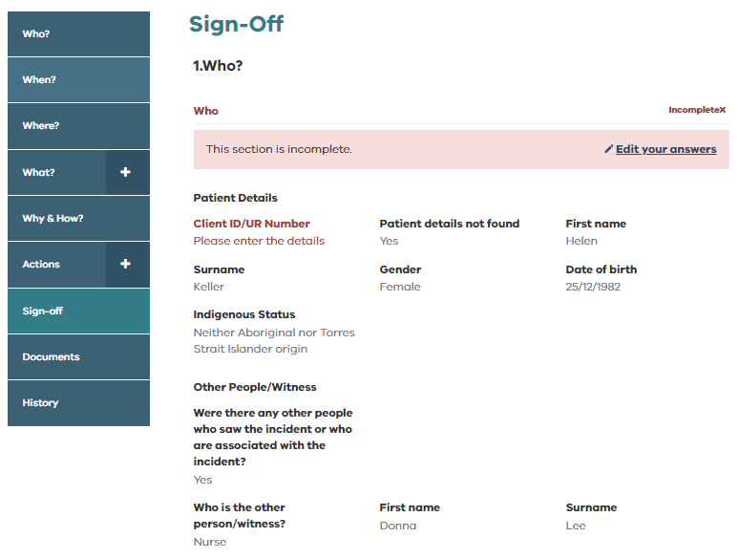
Managing incidents – sign-off
*For Managers
If a section is red, it means a mandatory field is incomplete.
Select Edit your answers to make changes.
You can use this same function to edit any responses you want to change before closing the incident.

Slide 49
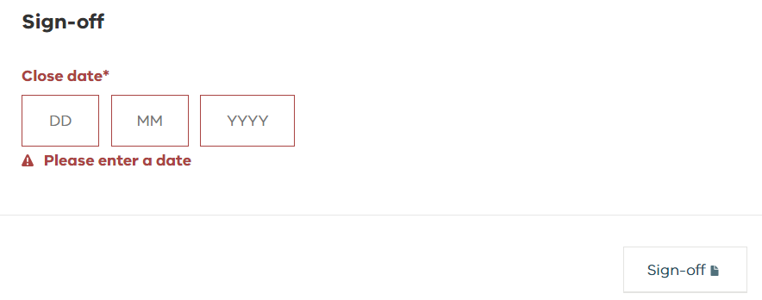
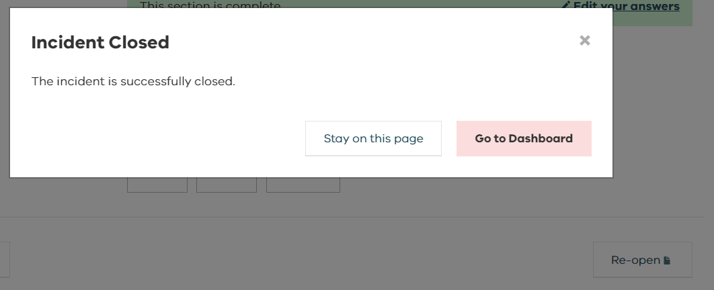
Managing incidents – sign-off
*For Managers
Enter the date the incident was closed, then select Sign-off.
You can back date the sign-off if required but the Close date cannot be before the Date of Incident.
You will receive the Incident Closed message when the incident has been closed.
The staff member who reported the incident will be notified the incident has been closed and will be able to view all fields.

Slide 50
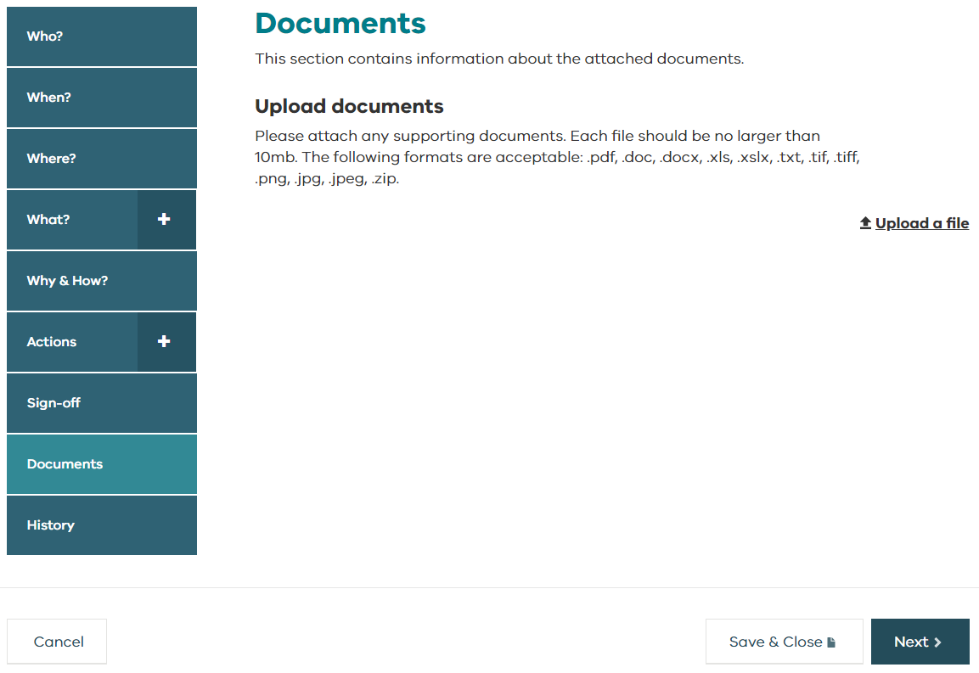
Managing incidents – documents
Choose Upload a file to attach a document to the incident.

Slide 51
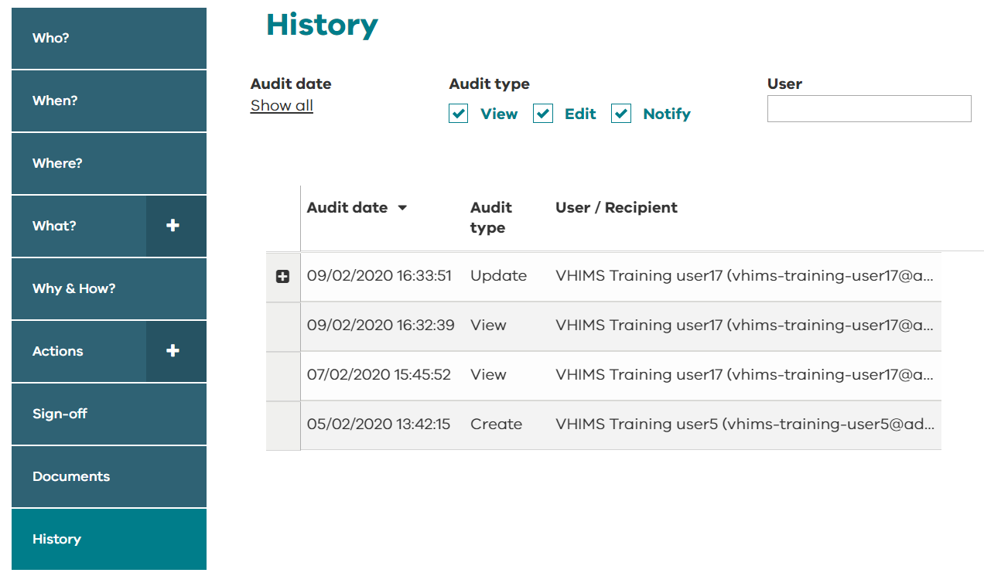
Managing incidents – history
This section shows the audit history of the incident.
History can be filtered by audit date, audit type, and user.
The audit history shows:
Who created the incident
Who viewed the incident
Who updated the incident and details of any changes
Who was notified (includes email notifications sent to managers, reporters, teams as part of notification rules, and when any actions are assigned).
Tip! | Adjust the filters on the history page to ‘Audit date’ – show all and select all ‘Audit types’ if you want to see the full history of the incident.

Slide 52
Actions dashboard
Actions dashboard

Slide 53
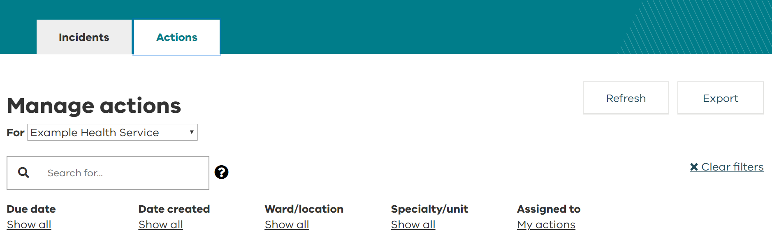
Actions dashboard
Every user has access to the Actions tab.
Click on Actions to go to the Actions dashboard.

Slide 54
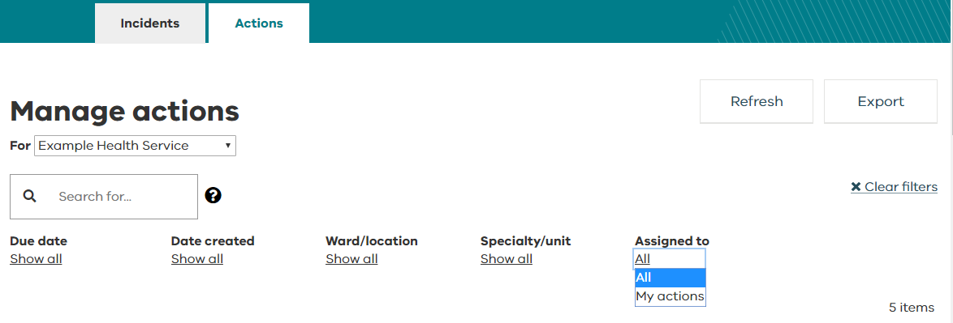
Actions dashboard
If any actions have been assigned to you, they will appear on your actions dashboard.
This dashboard has similar functionality to the incidents dashboard i.e. allowing you to search, filter, export actions data, and edit an action.
It defaults to displaying only the actions allocated to you.
To see all actions related to incidents and feedback records that you have access to, change the ‘Assigned to’ filter to All.

Slide 55
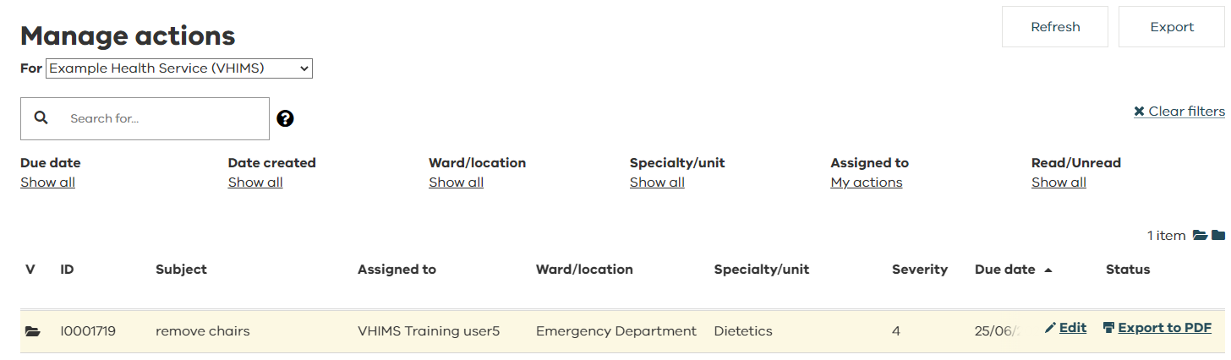
Actions dashboard – edit an existing action
To update an action from the dashboard (complete the assigned action, edit, view etc.), double click or hover over the incident and select Edit.
The incident will open into the assigned action ready for you to edit.
Tip! | Completed actions will no longer appear on your actions dashboard. You can still see these actions if you edit the incident from your incidents dashboard.

Slide 56
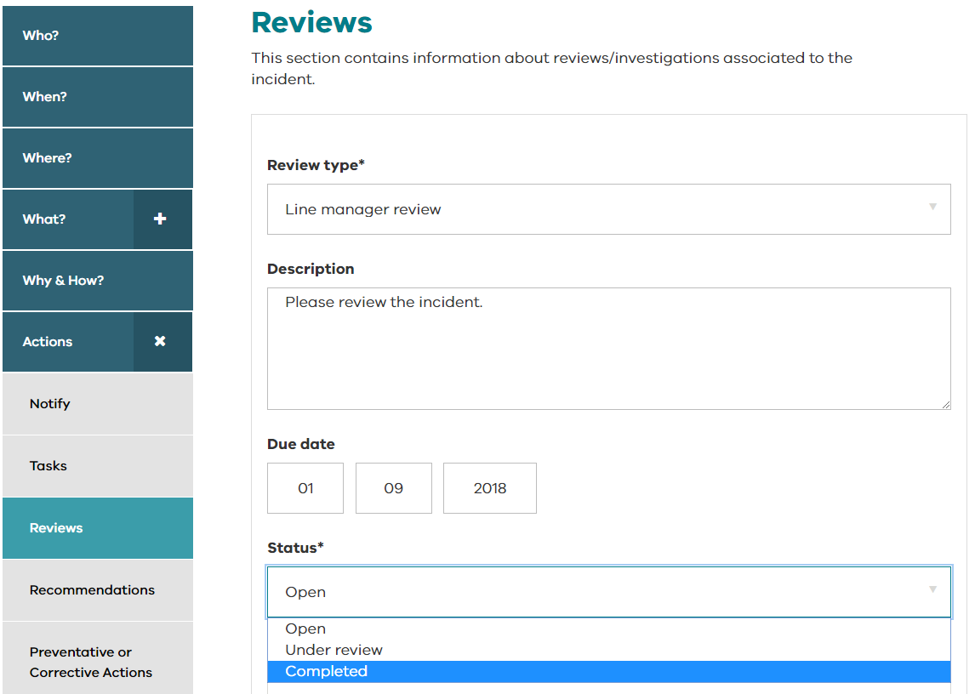
Actions dashboard – edit an existing action
You can also edit actions from the Actions section of the incident.
Fields will look different depending on the type of action assigned to you.
Edit the action and add any additional details or comments.
Change the status by selecting the appropriate option from the drop-down list and click ‘Save’ and then ‘Save and Close’ from the bottom of the page.

Slide 57
Reports
Reports

Slide 58
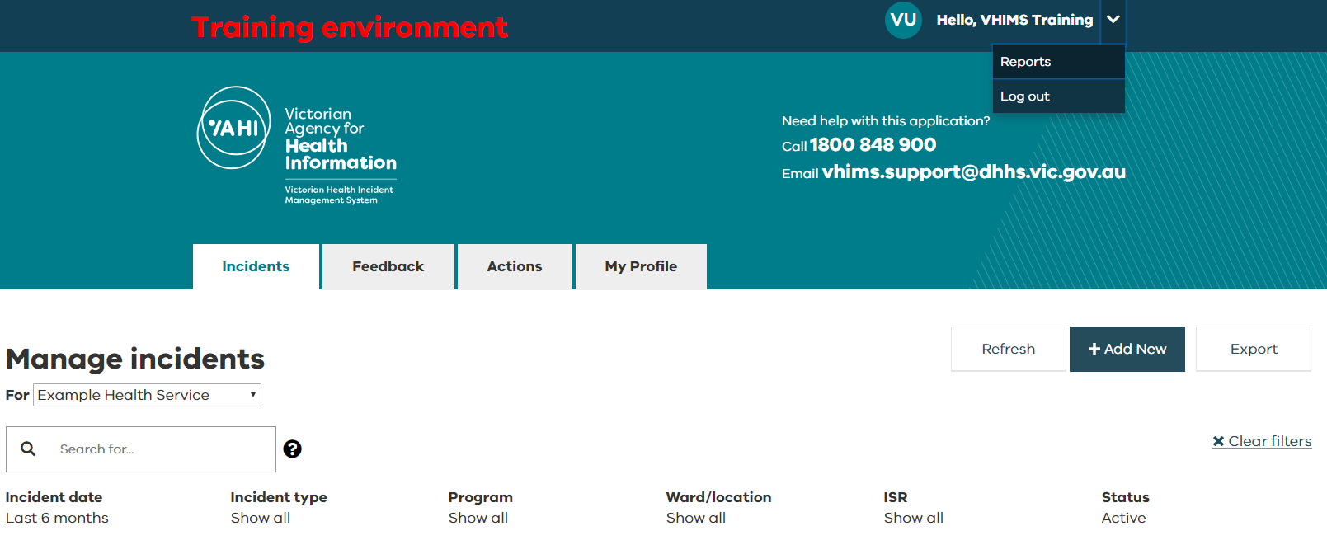
Reports – accessing reports
All users have access to these reports.
When you select Reports, they will open on a new tab on your internet browser window.
Information provided is summary only – no identifiable data is available through this reporting function.
Be patient while the reports load.

Slide 59
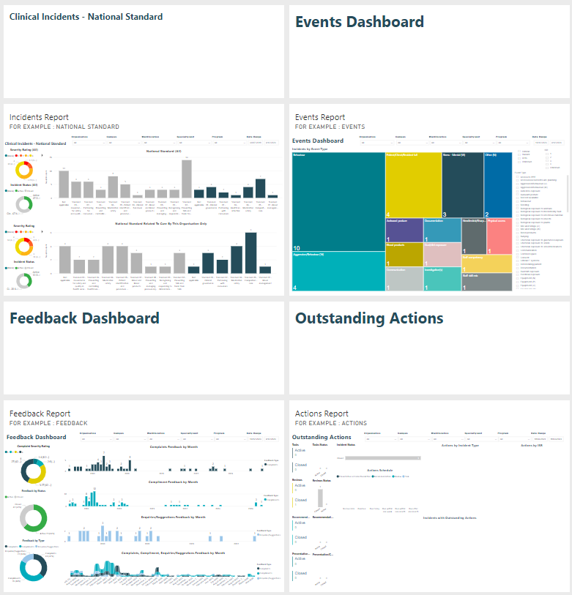
Reports – accessing reports
Reports have been made available to provide visibility across four organisation-wide data dashboards:
  Incidents
  Events
  Feedback
  Actions
When you select the title tile above a dashboard, the dashboard will open in another tab.

Slide 60
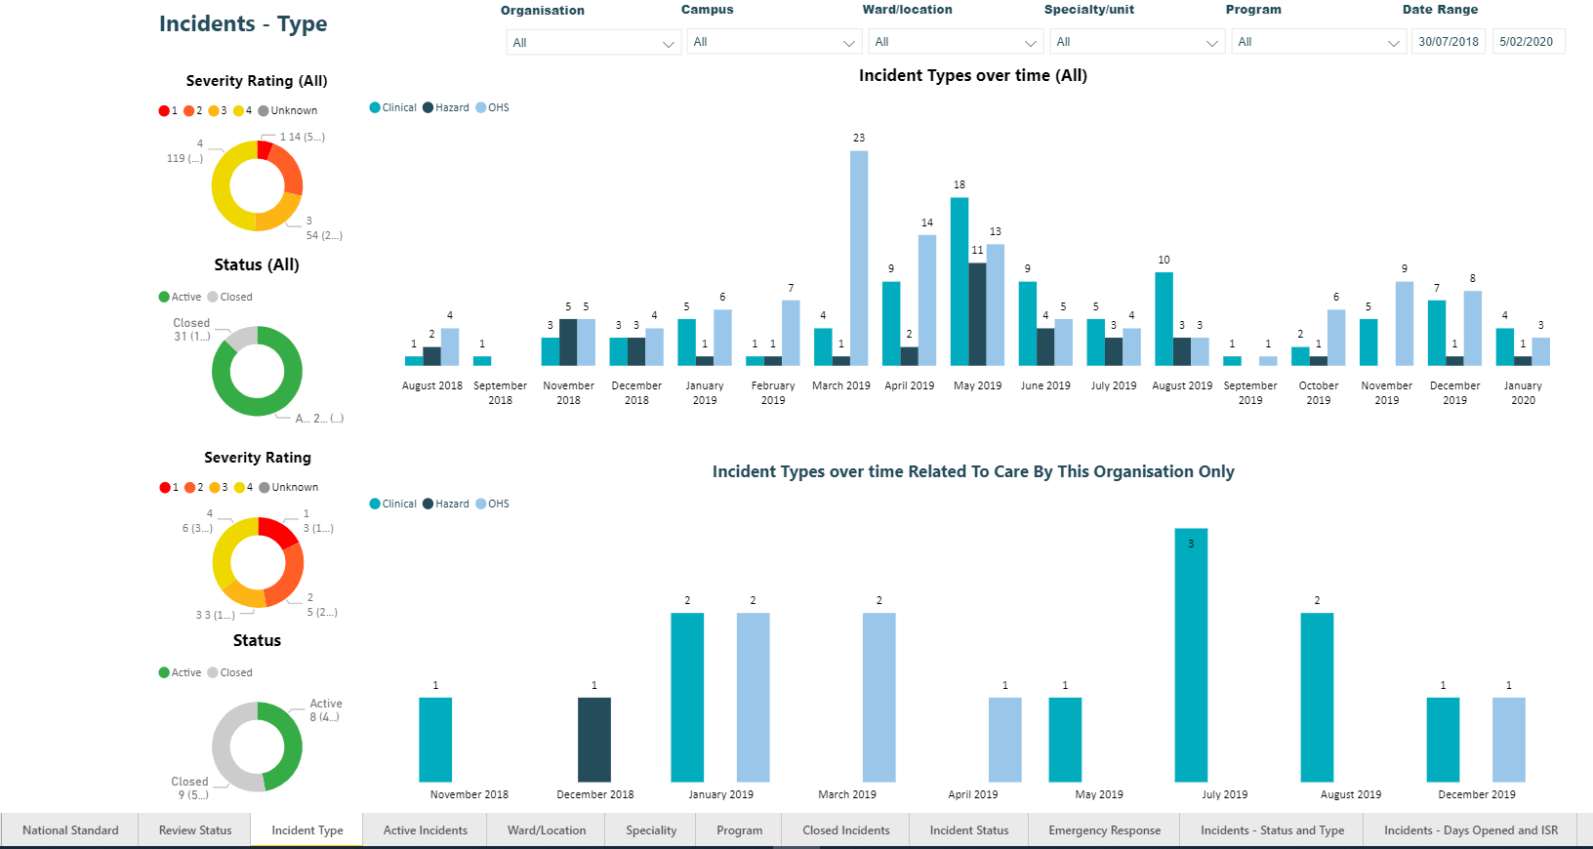
Reports – filtering data
The fields that you can filter through to build your report are positioned along the top of each of the four available reporting dashboards.
You can filter by:
  Organisation
  Campus
  Ward/location
  Specialty/unit
  Program
  Date range (Date of incident)
There are also additional tabs of data on separate tabs located at the bottom of the page.

Slide 61
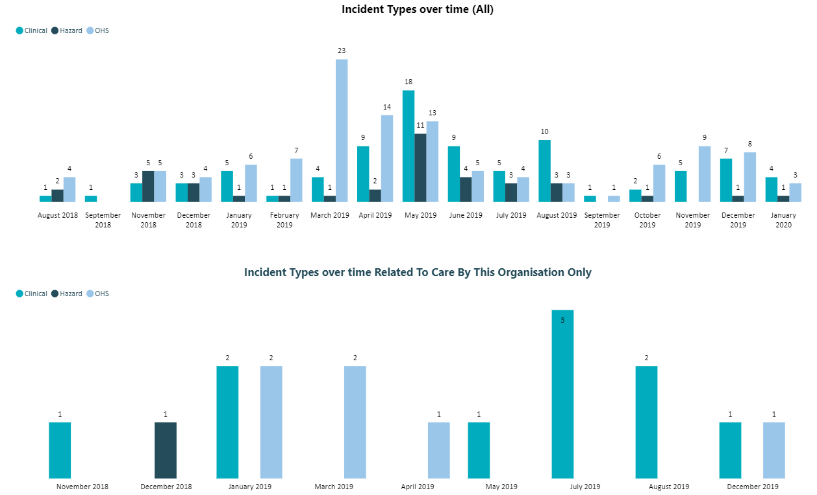
Reports – Related to care by this organisation only- only displays VHIMS 2 MDS Version 1 data (prior to 23/1/25)
In the ‘Why and How’ section completed by managers, there is a question ‘Is this incident related to care provided by this organization?’ (refer to why and how).
Following review, incidents where the answer to this question is ‘no’ will be removed from the counts.
The associated reports will only display records where the answer to that question is ‘yes’.
The ‘Related to Care by this Organisation Only’ reports are available by:
National Standard
Review Status
Incident Type
Active Incidents
Ward/Location
Specialty
Program
Closed Incidents
Incident Status

Slide 62
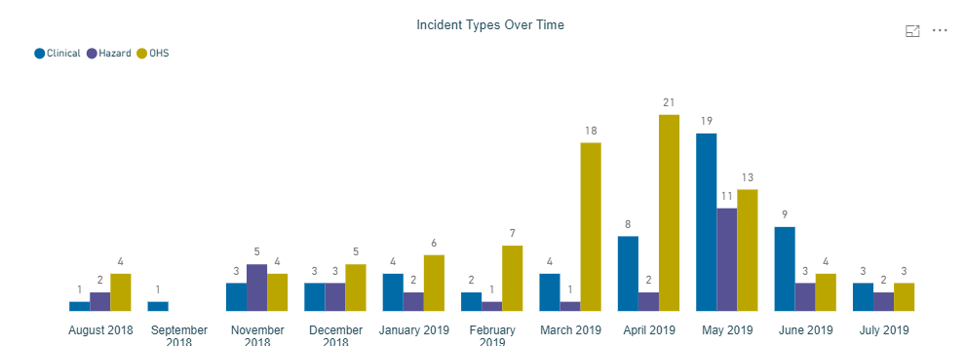

Reports – enlarging charts and exporting data
To enlarge a particular data chart, hover over the top right-hand corner.
Click on this icon to enlarge the desired data chart.
To export summarised data from a chart, hover over the top right-hand corner until the three dots appear.
Click on the three dots to display options, and export desired data into a CSV or XLS file by selecting ‘export data’ (this will not contain incident specific data).
Tip! | If you require incident specific data, use the ‘Dashboard Export’ feature from your incident, actions, or feedback dashboards in VHIMS CS. If you need to report on all incidents/feedback across your organisation, ensure you have the right permissions based on your role (refer to system roles and permissions).

Slide 63
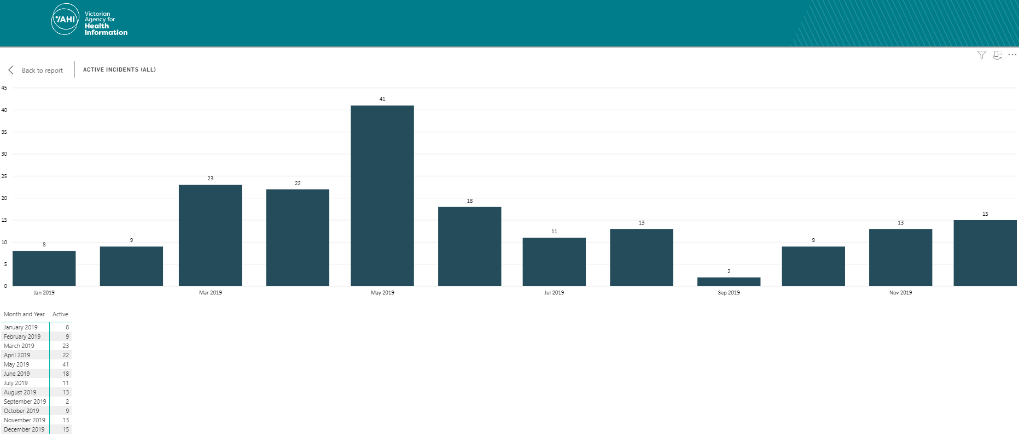
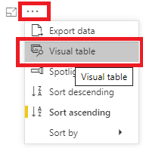
Reports – printing reports and adding a visual table
To print reports:
Use the ‘Snipping tool’ or ‘Snip & Sketch’ to select the area you want to print or
Use key keyboard shortcut: PrtScn (print screen) to print your whole screen. To edit the screenshot, paste it into the program ‘Paint’.
Select ‘Visual table’ if you would like to include the data table. This will also enlarge the report.

Slide 64
Cloning incidents
Cloning incidents

Slide 65



Cloning incidents
*For Managers
Users with a role of ‘Helpdesk’ or ‘Executive’ can clone incidents from the Incidents dashboard.
When +Clone is selected, a dialogue box will open, and the user may choose which type they want the cloned incident to be.
When the incident is cloned, a message will appear at the bottom of the page:

Slide 66
Cloning incidents
*For Managers
The cloned incident is saved as ‘Related’ to the original incident.
Once the cloned incident has been created, open it and go through all the pages to complete/edit any missing information.
When the cloned incident type is the same as the original incident type (e.g. Clinical to clinical) all answers from the following tabs are copied: Who, When, Where, What, Why & How, Worksafe (OHS staff incidents only).
When the cloned incident type is different from the original incident type (e.g. clinical to hazard), only questions that are common across all incident types are copied.
The status of a cloned incident will not necessarily be the same as the original incident.
Tip! | Answers to questions from the ‘Actions’ tab and ‘Sign-off’ tab are not complete.

Slide 67
Profile delegation
Profile Delegation

Slide 68

Profile delegation
*For Managers
My Profile module allows users with these system roles to temporarily delegate their VHIMS CS incidents and feedback to another staff member:
Manager
OHS manager
CLO
Risk manager
Executive
System administrators (Helpdesk and Organisation Admin roles) and VHIMS Support have access to manage users and can set up delegation on someone’s behalf.

Slide 69
Profile delegation
*For Managers
If you delegate to another user (or if a system administrator delegates on your behalf), the delegated user will be able to:
  receive all email notifications that you receive (you will also continue to receive notification emails while the delegation is in effect).
  view all the incidents and feedback records that you see on your dashboards.
The delegated user will be able to edit the fields they can access based on their delegated system role. For example:
  Reporters will have access to Feedback.
  Reporters and Staff will be able manage incidents (edit the ‘Why and How’ section) close or re-open incidents and feedback.
Delegation can be created for a user even if the user status is ‘inactive’ in the system.
The system allows for chained profile delegation – the delegated user can further delegate to another person (e.g. User A can delegate to User B who can delegate to User C).

Slide 70


Profile delegation
*For Managers
Check the box to ‘Delegate?’
Start typing the name of who the user would like to delegate to in the ‘delegate to’ field.
Delegation can only be for a period of time – enter a start date (the start date must be greater than today).
Enter an end date (if known). If an end date is not specified it will be an ongoing delegation.
Select to save your changes.
To cancel a delegation, de-select the box ‘Delegate?’.
Tip! | A user can only have one delegation. If you can’t find their name in the ‘Delegate to’ field, they may have already been delegated to by another user.

Slide 71
Logging off
Logging Off

Slide 72


Logging off
Remember to log off the system by selecting the arrow next to your name in the top right corner and choosing ‘Log out’.
If you don’t log off, the next time you attempt to log in, you may need to log out and back in to refresh the session.

Slide 73




For further information
For further information
Contact your local VHIMS CS administrator
Contact the VHIMS team: vhims2@vahi.vic.gov.au
Contact VHIMS Support using the details below:
1800 848 900
VHIMS CS education and training resources
vhims@support.vic.gov.au

